Slide 1
Sports Therapy
Presented by David Villasenor of the Academy of Science and Medicine

Slide 2
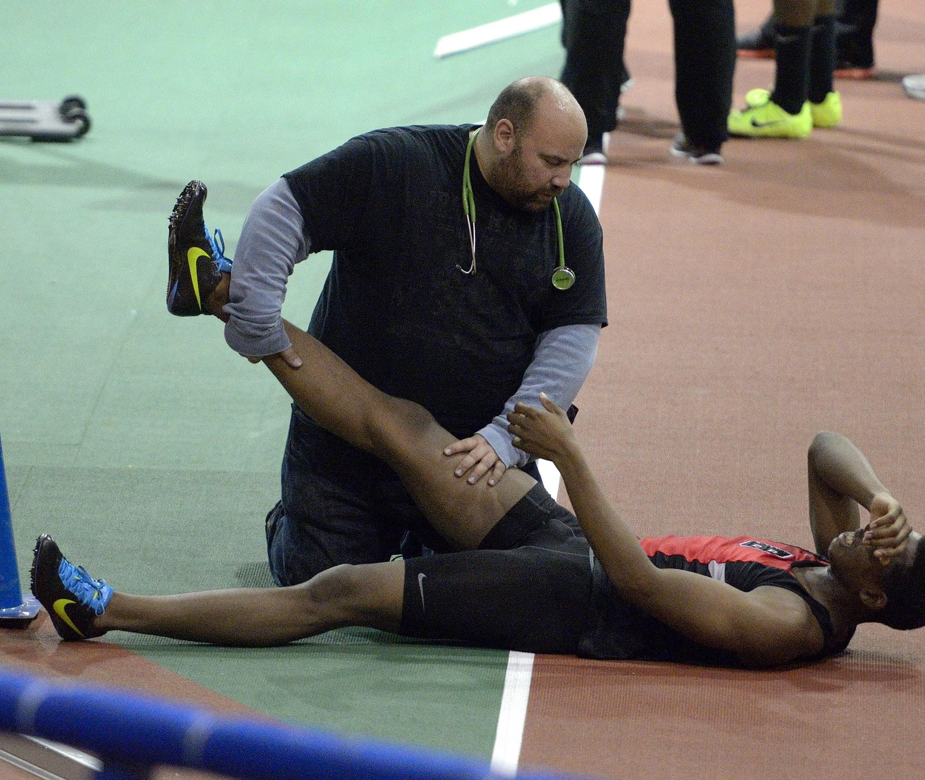
What is Sports Medicine
A branch of medicine that deals with physical fitness and the treatment and prevention of injuries related to sports and exercise.

Slide 3
New Pathway at CV
Sports Medicine
Sports Therapy
Internship

Slide 4
Saint Francis HS Sports Medicine Competition At CSUN

Slide 5
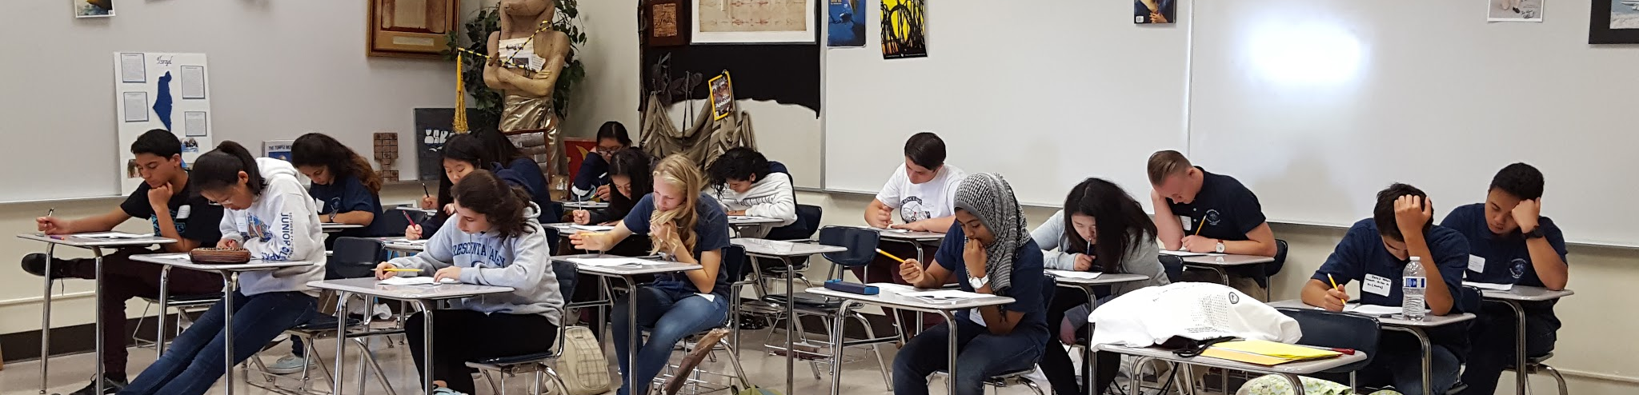
The Written Exam
Consists of 100 Questions centered around Sports Medicine. Topics include but are not limited to:
First Aid (CPR, Shock, etc.)
Medical Terminology
Anatomical Structures and Physiology
Evaluation Techniques

Slide 6
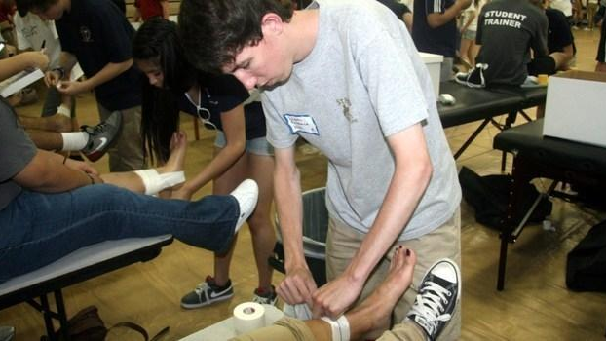
The Practical Exam
It consists of going through a First Aid Procedure, Palpation of an Anatomic Structure, Two Special Tests for ROM, and One Tape Job

Slide 7
Why Should You Consider Sports Medicine?

