Slide 1

Sports Med
By Sarah Karim, Ariana Coba
and
Suseong Cho

Slide 2
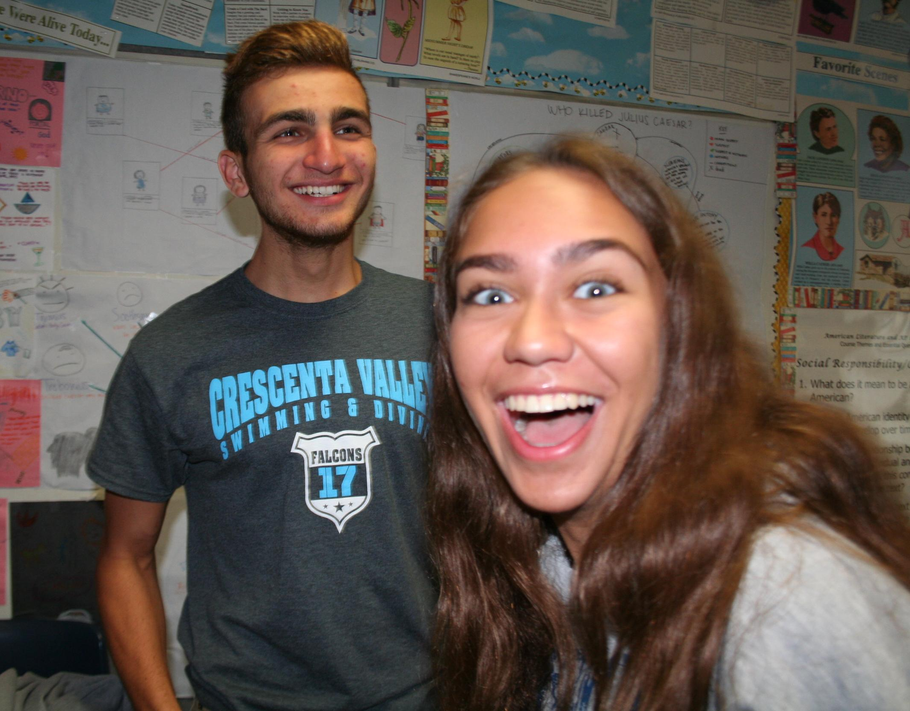
What Is Sports Med?
It is a branch of medicine that deals with physical fitness and the treatment and prevention of injuries related to sports and exercise.
The classes meet 6:30 in the morning on Tuesdays and Thursdays
Everyone is always energetic and excited to learn

Slide 3
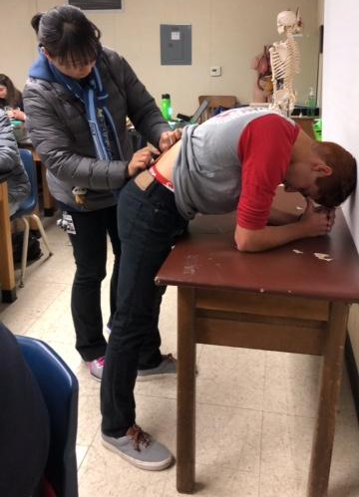
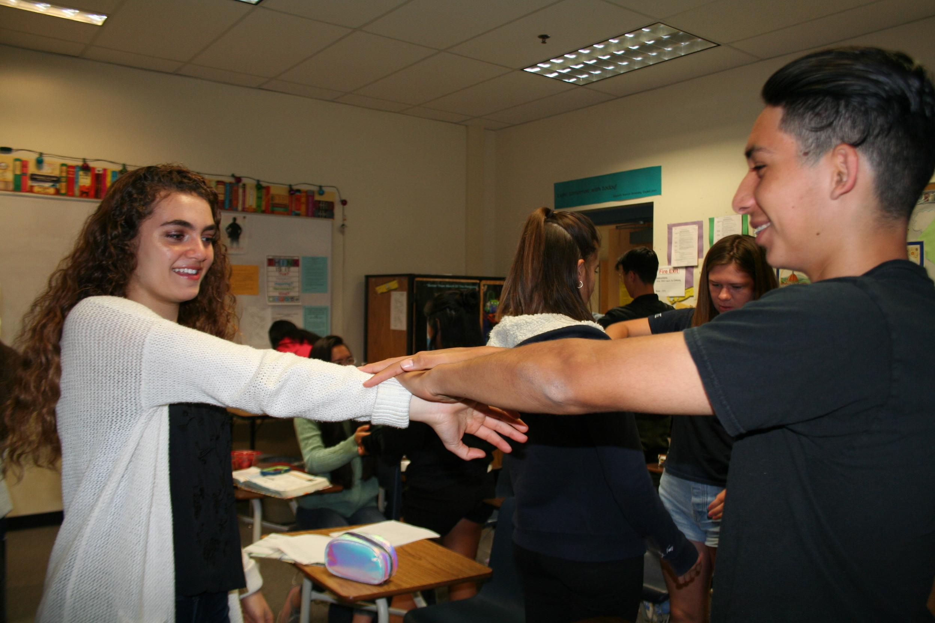
What Do We Learn About?
The course covers human anatomy and physiology, prevention, evaluation, treatment, and rehabilitation of an injury, etc.
Basically, we learn about treating and preventing sports related injuries

Slide 4
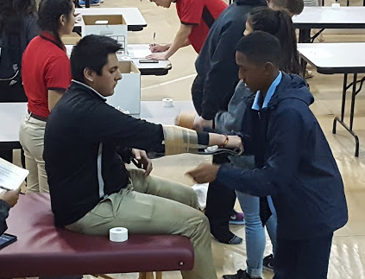
How Are We Graded?
We have a weekend HW assignment every other week
We have tests now and then, usually on anatomy
We have practical tests where we demonstrate our skills
We’re supposed to get 50 hours of sports medicine related events

Slide 5
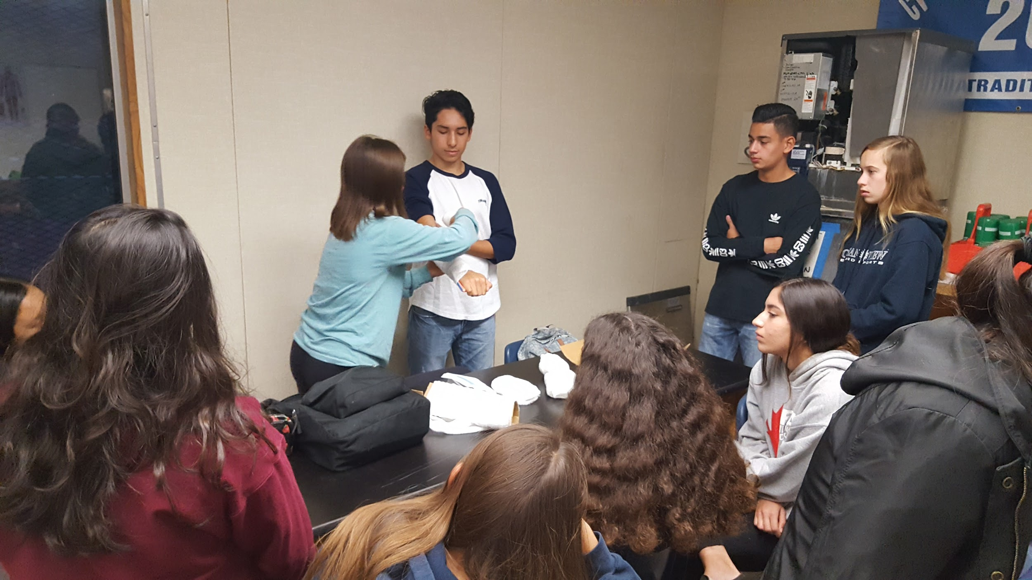
Seminars we’ve gone to
Saint Francis Sports Medicine Competition at CSUN

Slide 6
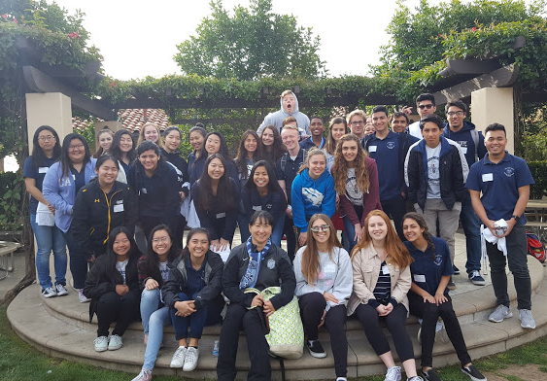
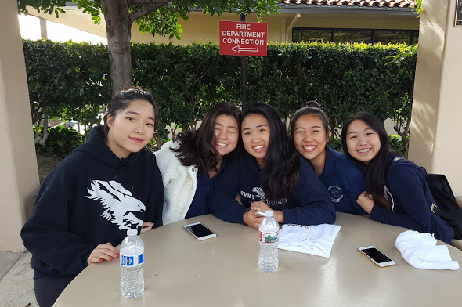
Places We’ve Been :)

Slide 7
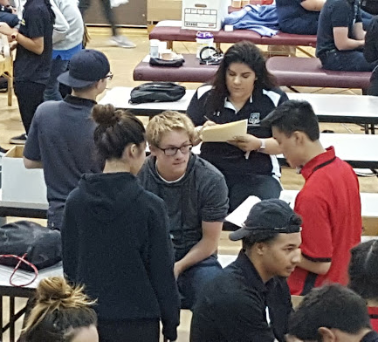
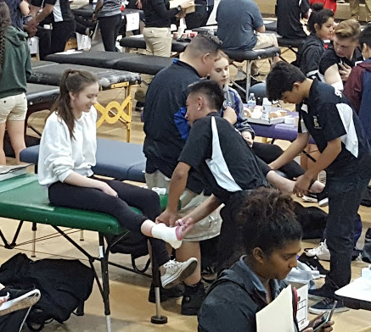
Places We’ve Been :) (cont.)

Slide 8
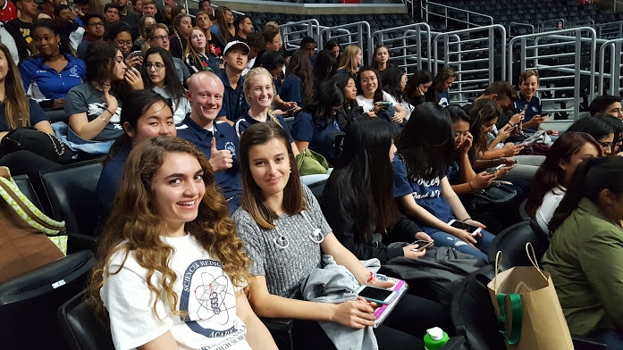
Places We’ve Been :) (cont.)

Slide 9
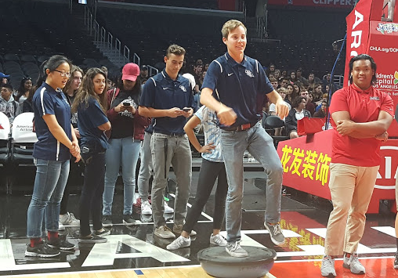
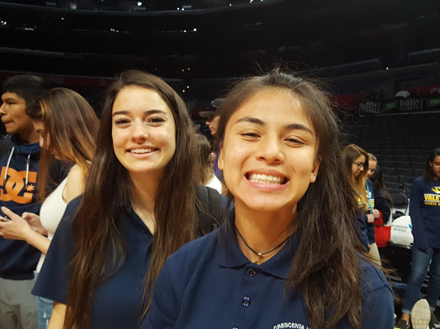
Places We’ve Been :) (cont.)

Slide 10
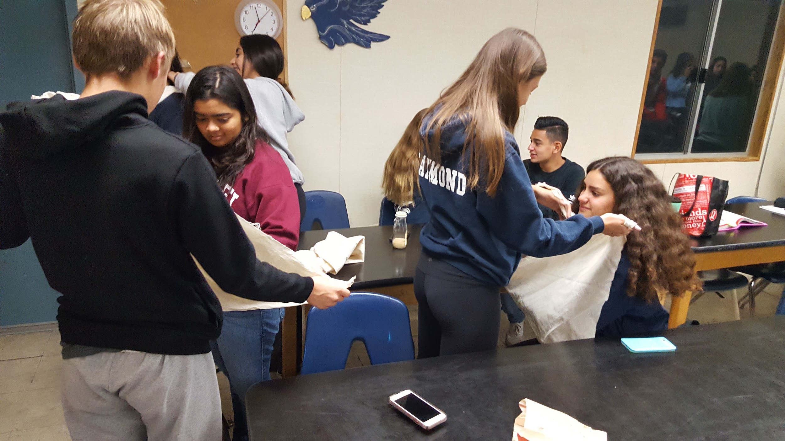
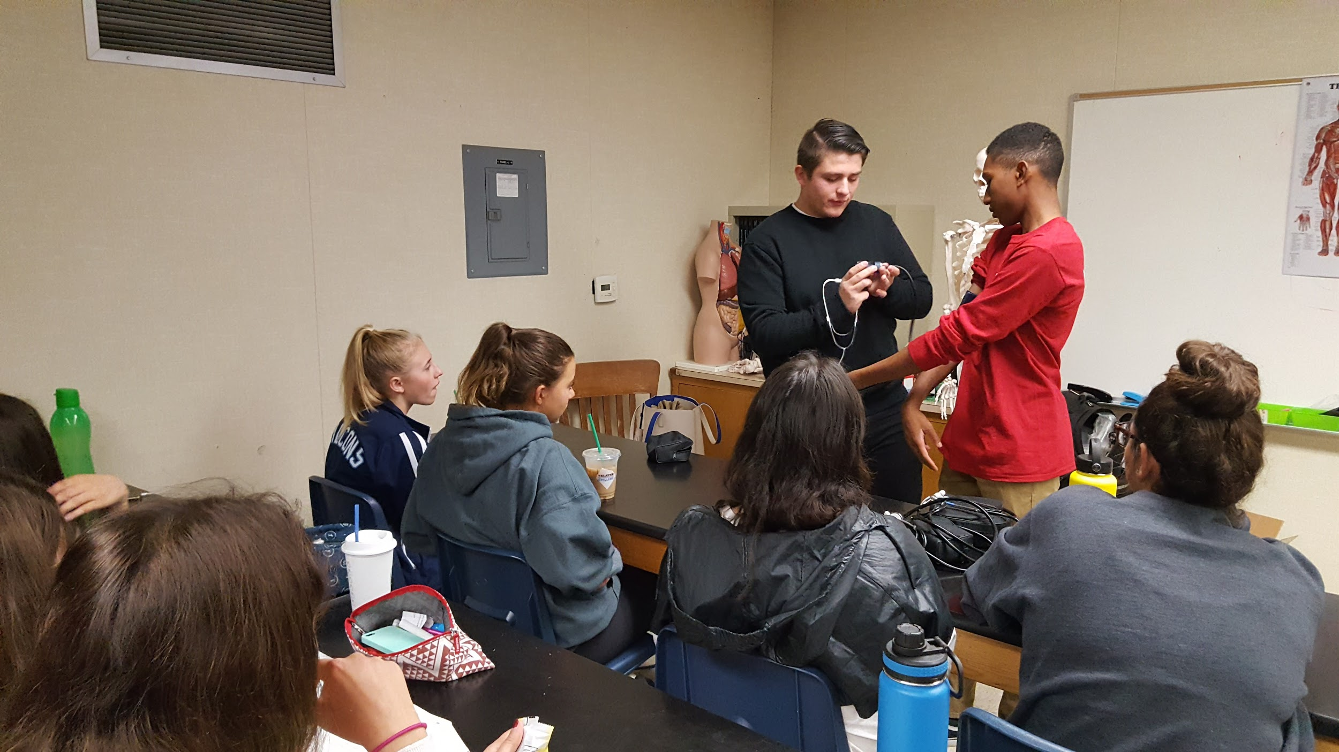
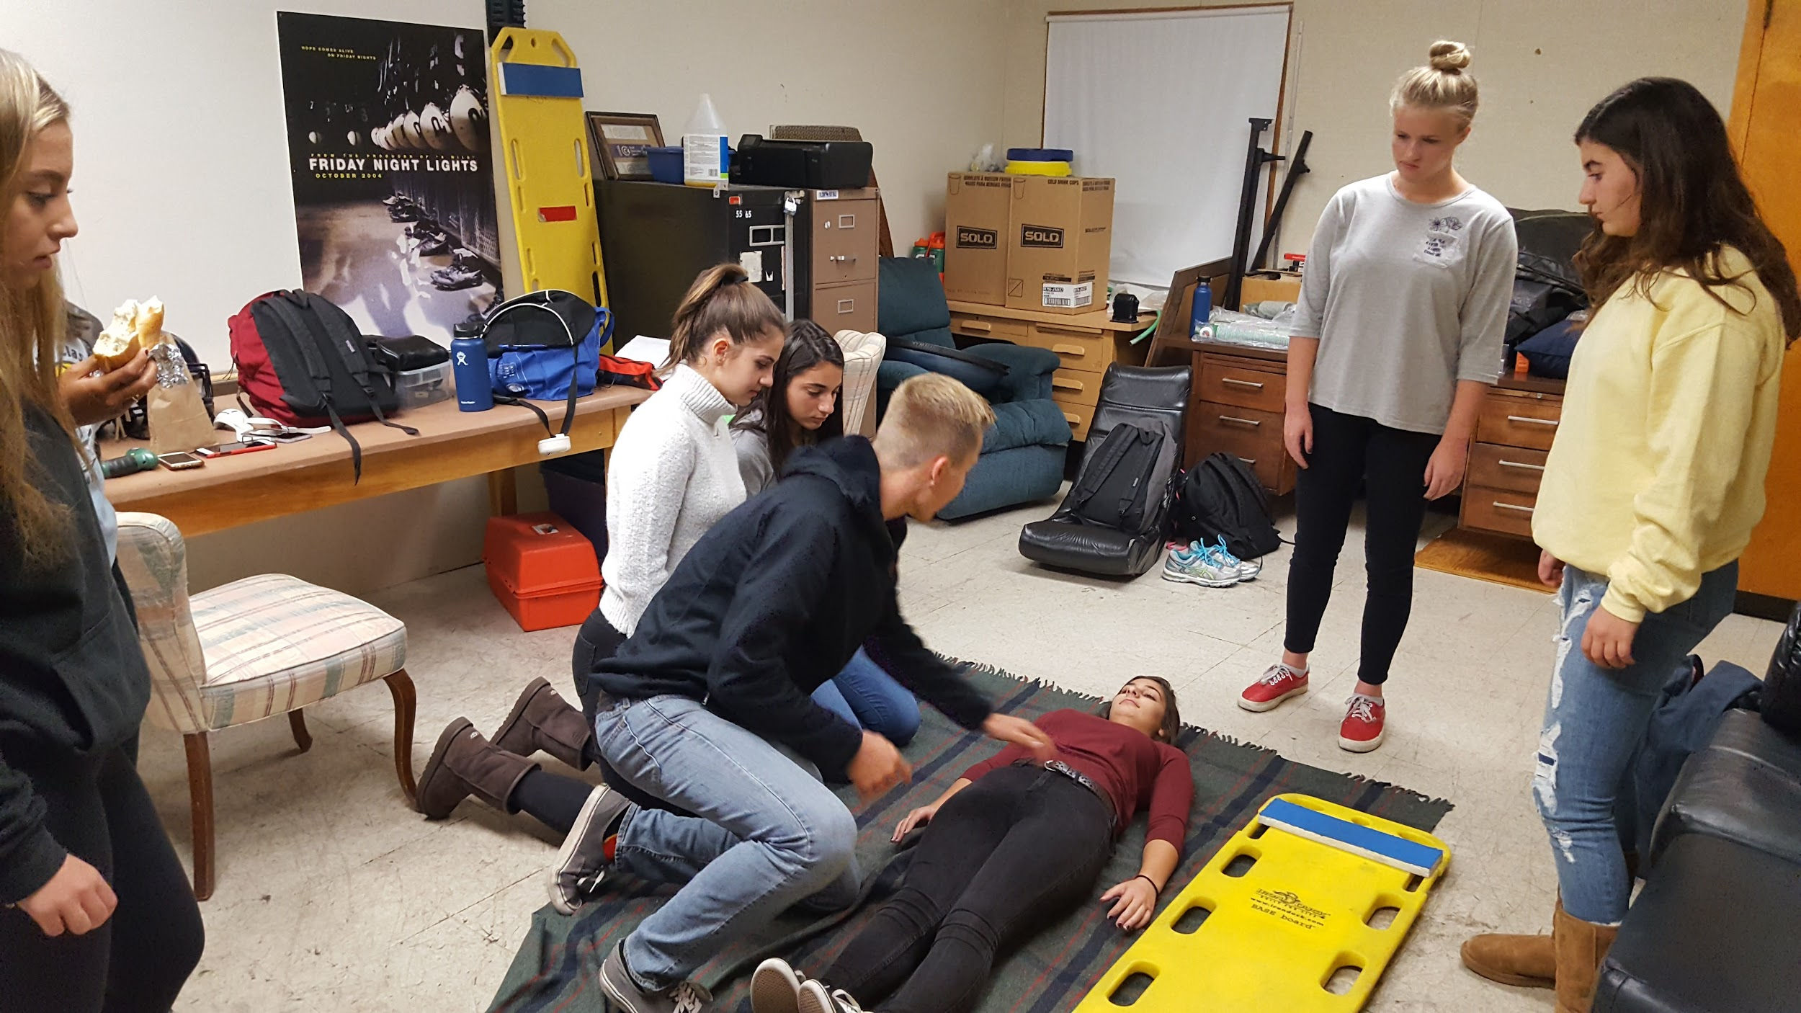
Class pictures :)

Slide 11
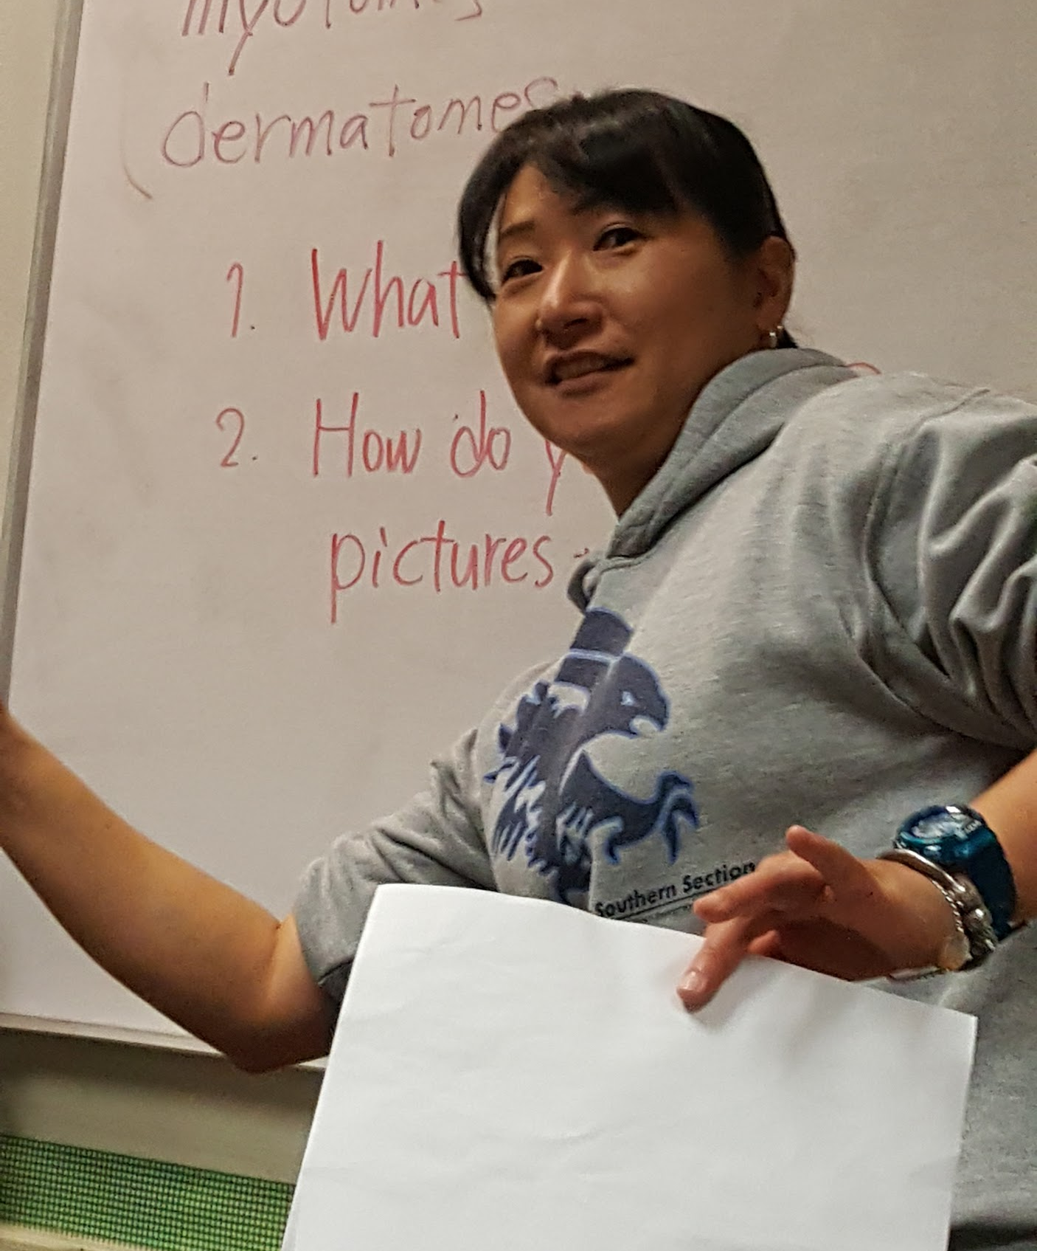

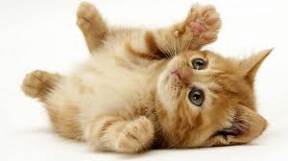
Our Wonderful Teacher….
Junko!!!! <3

Slide 12
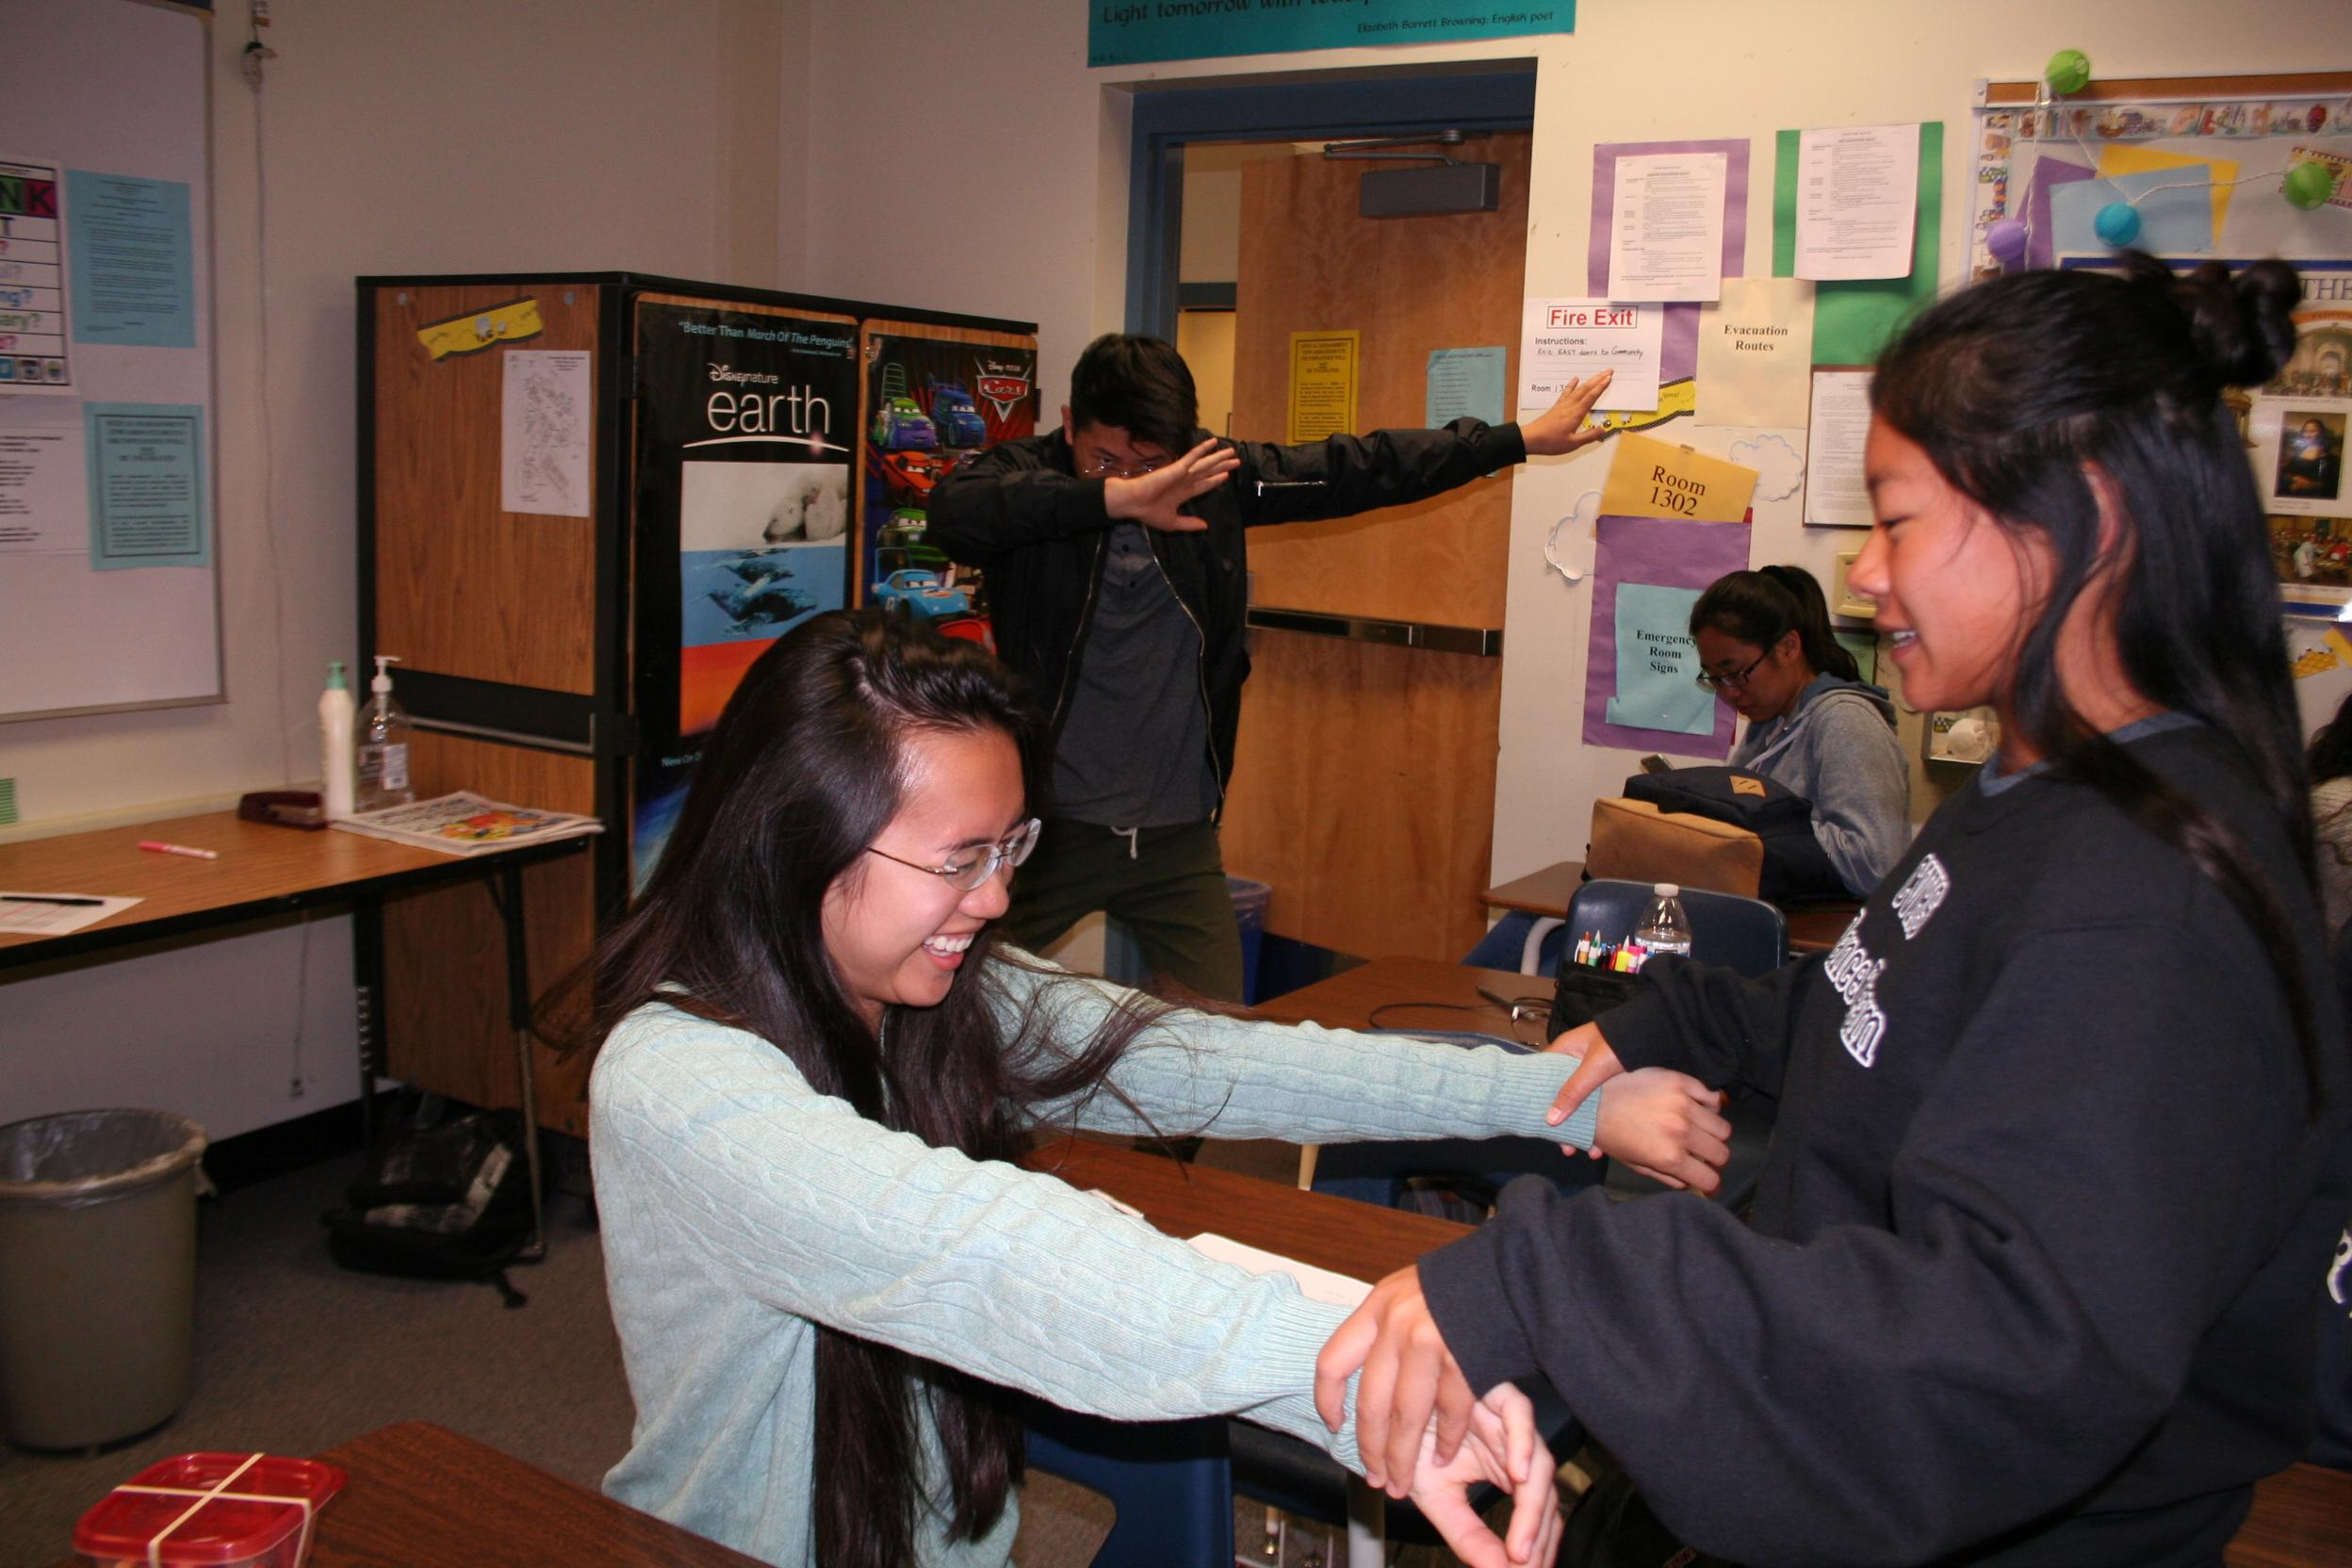
Thank You! :)
Questions?

