Slide 1
The Research Class
By Claire Gantan, Neve Speth, and Eileen Stiles

Slide 2
What do we do in the research class?
Given a broad topic to investigate
Conduct independent research
Learn to create a properly formatted research paper

Slide 3
Class Syllabus
Semester 1
  Focus on independent work
    5 hours weekly homework of independent research
  Individual research papers
  Self-led
Semester 2
  Focus on group work
    Still doing 5 hours weekly homework of independent research
  Synthesized research paper
  Group-led
  Science Fair
Notes:
neve

Slide 4

Benefits of Joining the Class
CTE class credit for Academy
Easy commitment
  Meets once a week (either snack, lunch, or before school)
Flexibility
  Can be taken either first semester, second semester, or both

Slide 5
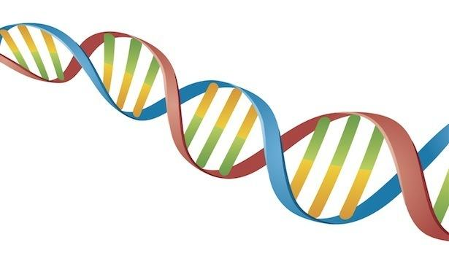
Research Focus
Epigenetics
  APOE e4 variant
  ALOX5
Nutrigenetics
Concussions
Notes:
Neve

Slide 6
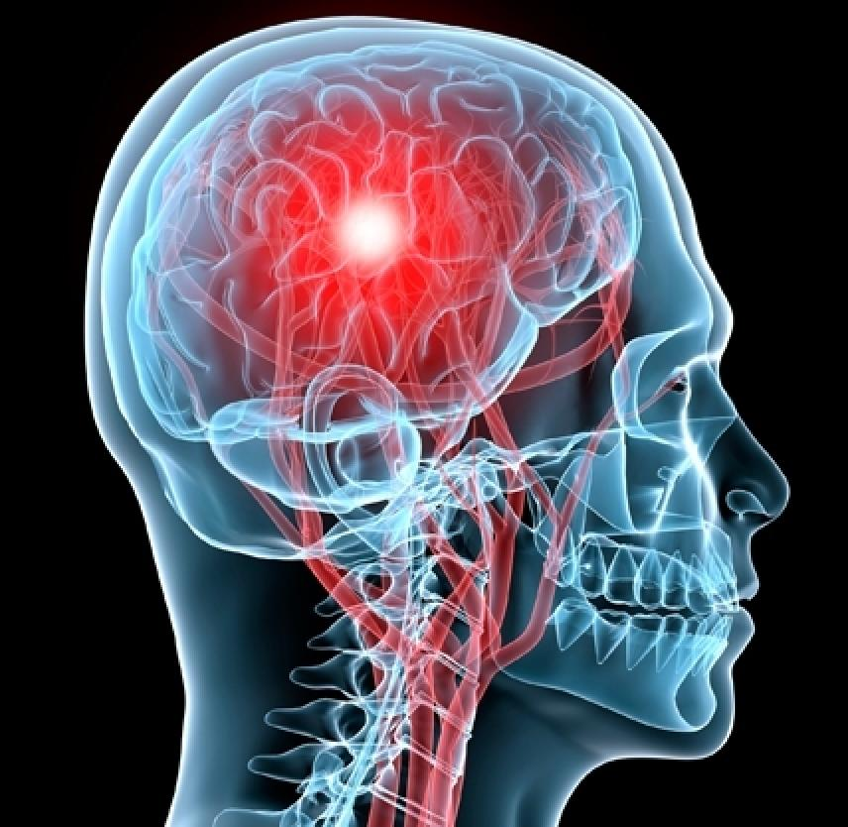
Purpose
Clarify and identify relationship between genetics and concussions
Recognized the dangers and long term effects of concussions
Find potential methods to minimize these effects
Notes:
Claire

Slide 7
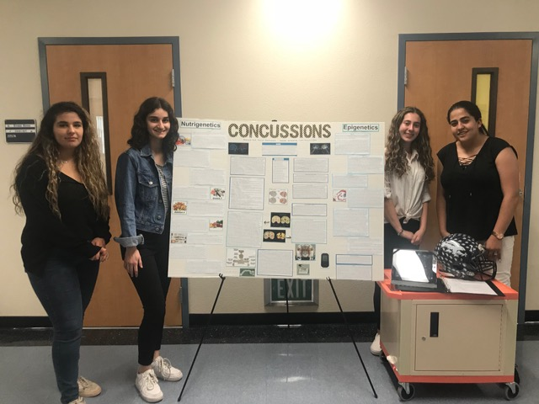
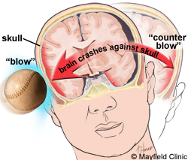
What are concussions?
a type of traumatic brain injury—or TBI—caused by a bump, blow, or jolt to the head
Notes:
Claire
Normally, your brain is surrounded by fluid that cushions the brain from injuries
When a person gets a concussion, their brain crashes against the skull, causing their brain to swell up as it attempts to heal itself. This is dangerous because it limits the amount of space available for fluid.

Slide 8
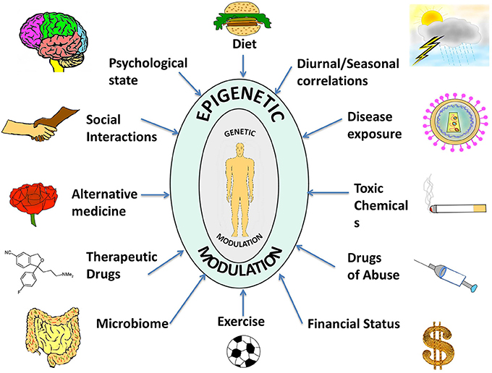
What is Epigenetics?
Changes in gene expression that don’t involve changes to the DNA sequence
How the environment impacts gene expression
Notes:
Claire
One example of this is lactose intolerance in humans, which impacts around 65% of people globally.
Infants are usually able to digest lactose with an enzyme called lactase. As people grow older and change their diet to include less dairy products, the amount of lactose consumed and the expression of the gene that creates lactase, declines, which leads to lactose intolerance.

Slide 9
Epigenetic Factors
DNA methylation
Histone modification
Oxidation

Slide 10
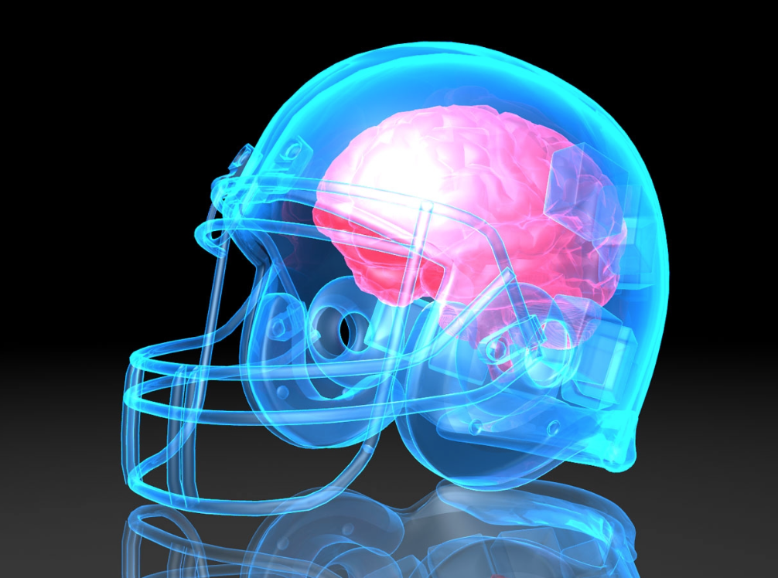
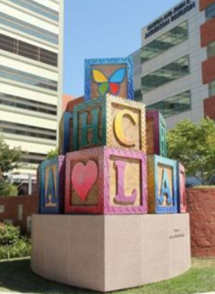
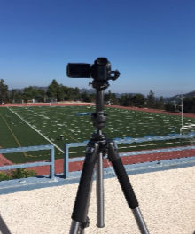
CHLA study
Goal:
  To understand how repeated impacts and concussions affect brain structure and function
Follows current freshman football players throughout football career in high school
Notes:
Neve

Slide 11
THANK YOU!

