Slide 1
Medical Terminology, EKG, HIt and
Medical Records
By: Maika Segarra, Khris Rodriguez, Mary Zakaryan and Melody Goral

Slide 2


Objective
Bewilder students with strange spelling and pronunciations of medical terms
Our goal was to successfully learn all medical terms
Allow students to gain hands-on experience with medical records

Slide 3

1st semester: Medical Terminology
Teacher: Mrs. Perera
Dual Enrollment with GCC (earn GCC credit!)
Tuesdays and Thursdays from 3:15-4:30pm
Receive a certificate after you have completed the class
FIVE units
Use moodle

Slide 4
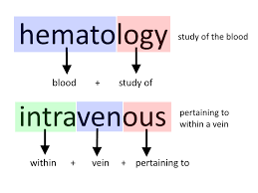
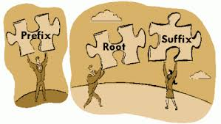
About the class
New class offered in the Academy
Correlates with what you learn in:
  AP Biology
  AP Psychology
  Physiology Honors

Slide 5

About the class
FIVE exams + individual assignments + group assignments = total grade
This is a college level class. Most of the work is independent and really gives a feel of what college will be like.

Slide 6

2nd Semester Medical records
Also taught by Mrs. Perera
THREE units
Receive certificate
Everything is completed/submitted online through MOODLE

Slide 7


About the class
WEDNESDAY 3:30-5:30pm
Hands-on experience to learn how to record patient information both accurately and efficiently
THREE exams + practice quizzes + group projects + individual assignments = final grade

Slide 8

about the class
Learn:
  about restrictions when it comes to sharing patient information
  The laws behind sharing patient records
  How to correctly record patient information and how to retrieve it

Slide 9


EKG
Teacher : Ms. Rodriguez
Class is held on Mondays and Wednesday
3:30-6:20
Used canvas- online assignments

Slide 10
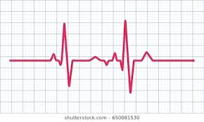
About the class
Basic nursing class
Teaches how to identify heart rate stripes and what type of heart rate it is
What type of heart disease a patient is diagnosed with and treatments
Designed to provide an overview and introduce the novice healthcare provider to the basics of electrocardiography (EKG).

Slide 11
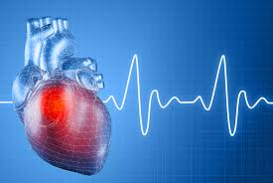
More INfo
Course content reviews principles of cardiac anatomy, physiology, and electrophysiology which are foundational to course content.
Includes cardiac hemodynamics, proper lead placement to obtain EKG waveforms, waveform identification, rate calculation, normal rhythm, and arrhythmia recognition and treatment.

Slide 12
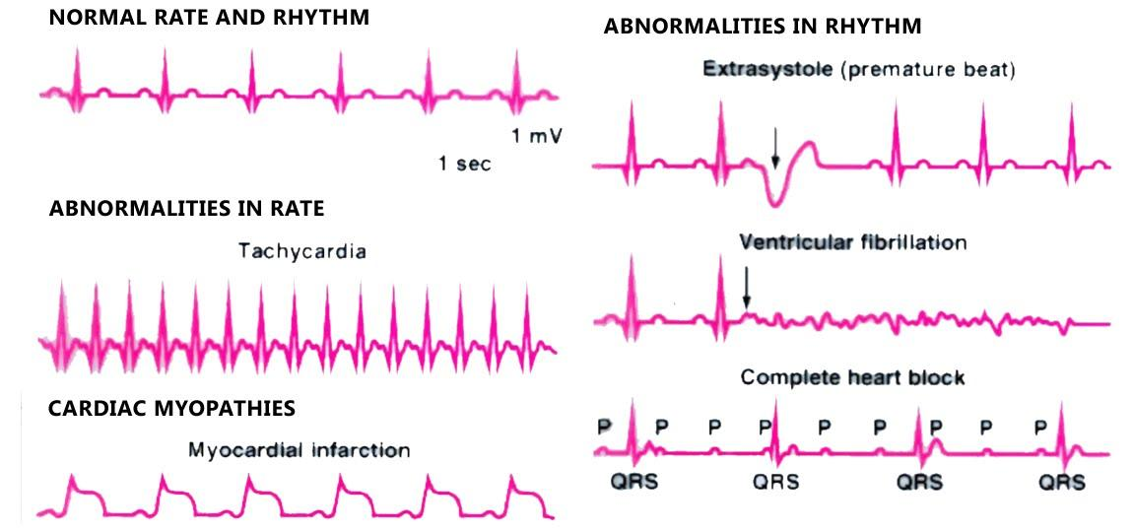
Pictures

Slide 13
HIT - Disease Process
Teacher : Mrs. Perera
Class is held on Mondays from 3:30-4:40 at CV
Uses Canvas for assignments

Slide 14
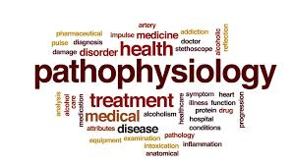
About the class
Provides information about our body
Types of diseases and prognosis treatments
Combines pathophysiology and pharmacology

Slide 15
Thanks for listening!!!!!

