Slide 1
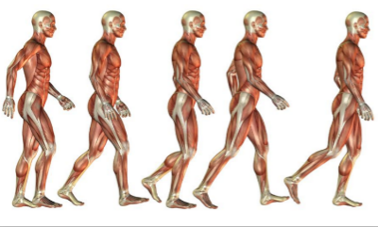
Kinesiology
By Dallas Kaauwai and Maika Segarra

Slide 2
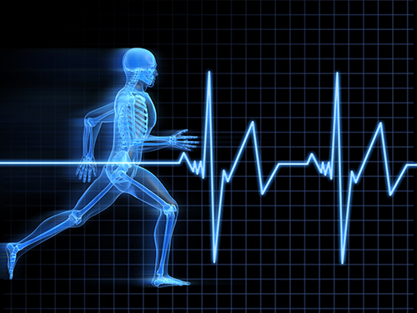
What is Kinesiology?
The Study of Motion
Gives students the technical, practical, and critical thinking skills of an athletic trainer in the field of a game
Taught by Coach Zargarian - Coach of Varsity Boys Basketball
Taught by Coach Harvey- Coach of Varsity Boys and Girls Cross Country and Track & Field

Slide 3
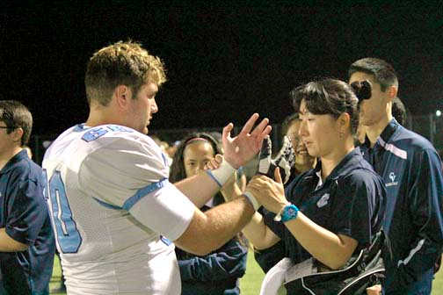
Basics Of Kinesiology:
Understanding basic concepts about motion and body mechanics
Study of human musculoskeletal and musculotendinous systems
Students learn about the involvement of muscles in motion
Students will also learn about the various joints that permit movement

Slide 4
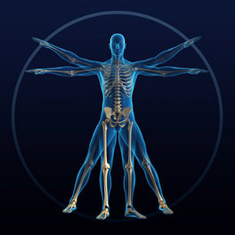
Basics of Kinesiology cont..
Topics that are covered include the various planes of the human body as well as anatomic positions
How different joint types enable either limited or free ranges of motion
A wide range of movement based terminology
The function of the various connective tissues in the body and how they affect motion

Slide 5
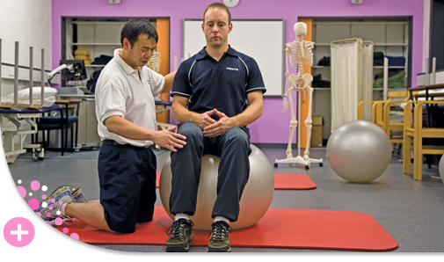
Additional Opportunities
Learn the Nutritional Aspect of an Athlete’s Proper Diet
  How many fats, proteins, or carbohydrates there are in certain foods
  Create a Nutrition Plan
Learn of the Psychological Aspect
  Help athletes how to cope with injury
  Rebuilding determination and initiative to play for injured athletes

Slide 6
Thank you for listening!!!

