Slide 1
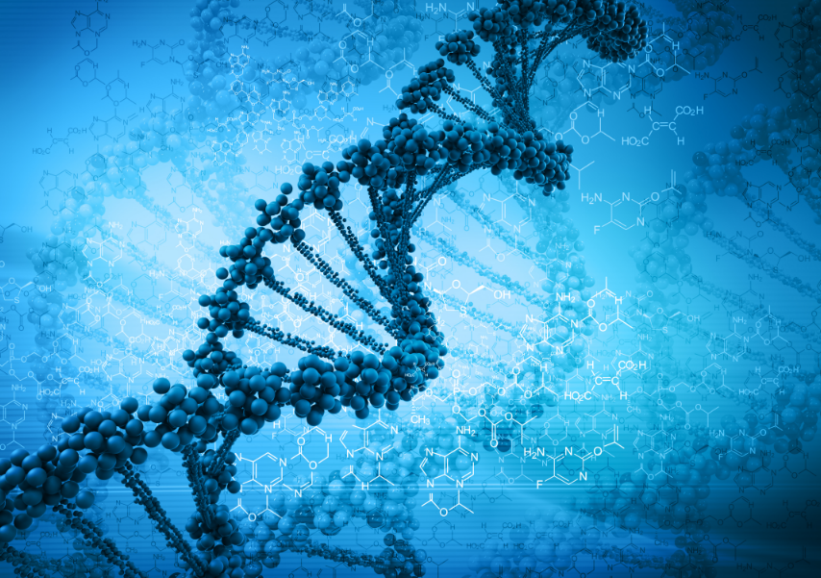
BIOTECHNOLOGY
BY: Jiyoun Roh, Sophia James, and Lena Shim

Slide 2
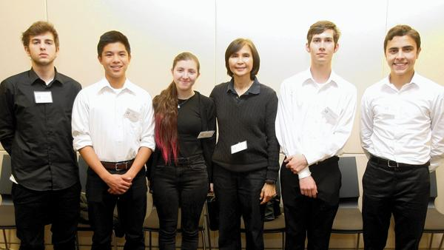
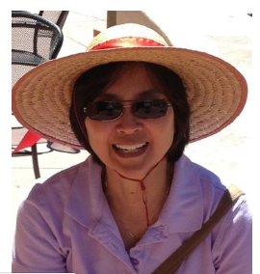
Our Instructor
Ms. Tuason, who is also the Academy coordinator, has been teaching biotech since 2004
She teaches biotech after school until 6 every Tuesday and Thursday
She has also been teaching AP Biology and Medical biology at CV since 2003, and works at the hospital as a microbiologist and clinical laboratory scientist
She has lots of lab work experience!

Slide 3
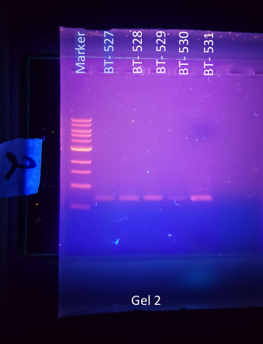
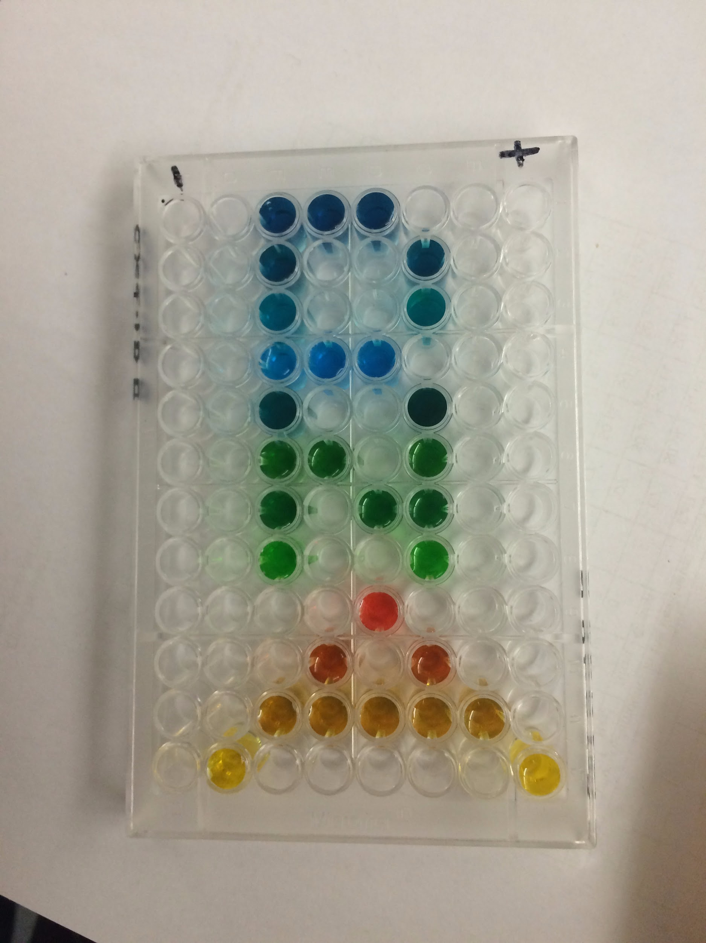
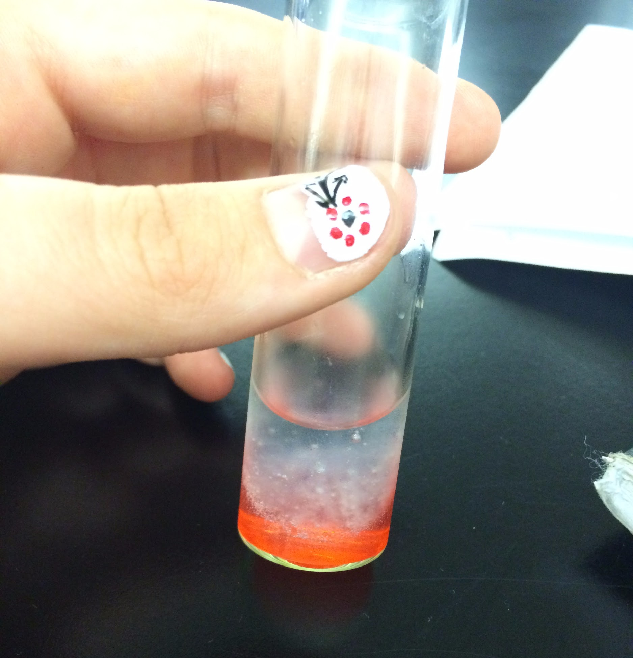
What is biotechnology?
Biotechnology is the study and manipulation of living things to yield a biologically useful product
Biotechnology fulfills the 10th grade technical class requirement for the Academy of Science and Medicine
  It is offered during the school year and during the summer for those with schedule conflicts (band, sports, etc.)
Biotechnology provides you with hands-on experience and skills that some students learn for the first time in college

Slide 4
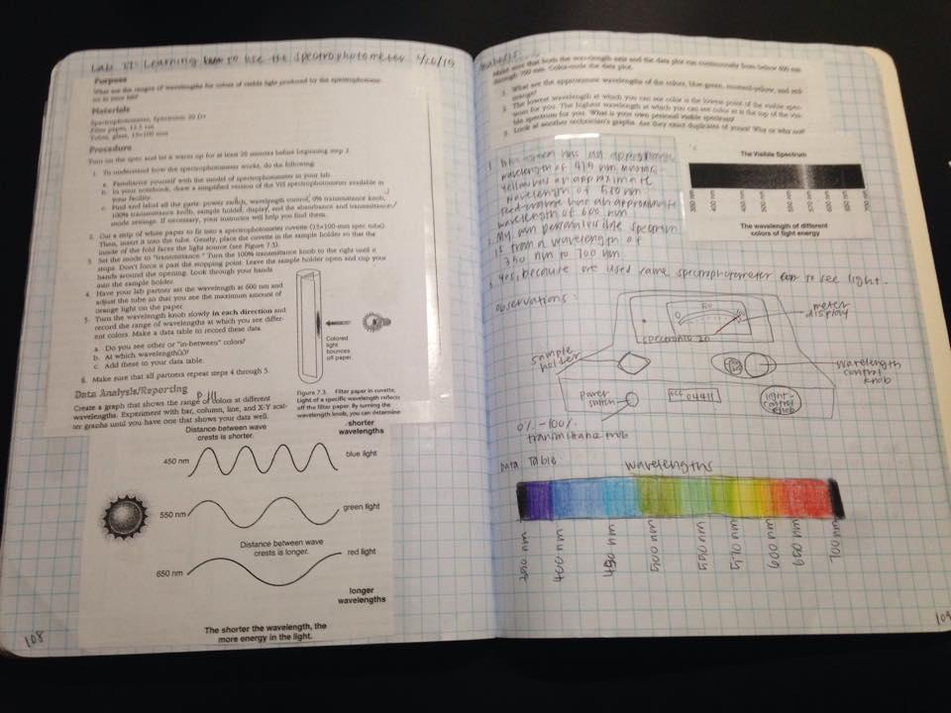
Lab Notebooks
Lab notebooks are a key essential to biotech because it keeps track of our work and experiments from throughout the year.
It is always important to record the date and details of the formation of the lab, data with picture or charts, and the conclusion so that you can go back and review your findings

Slide 5
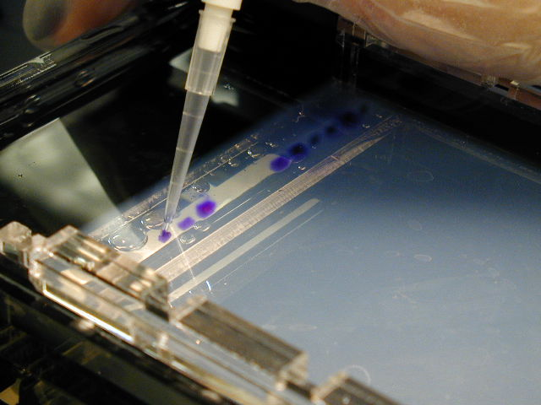
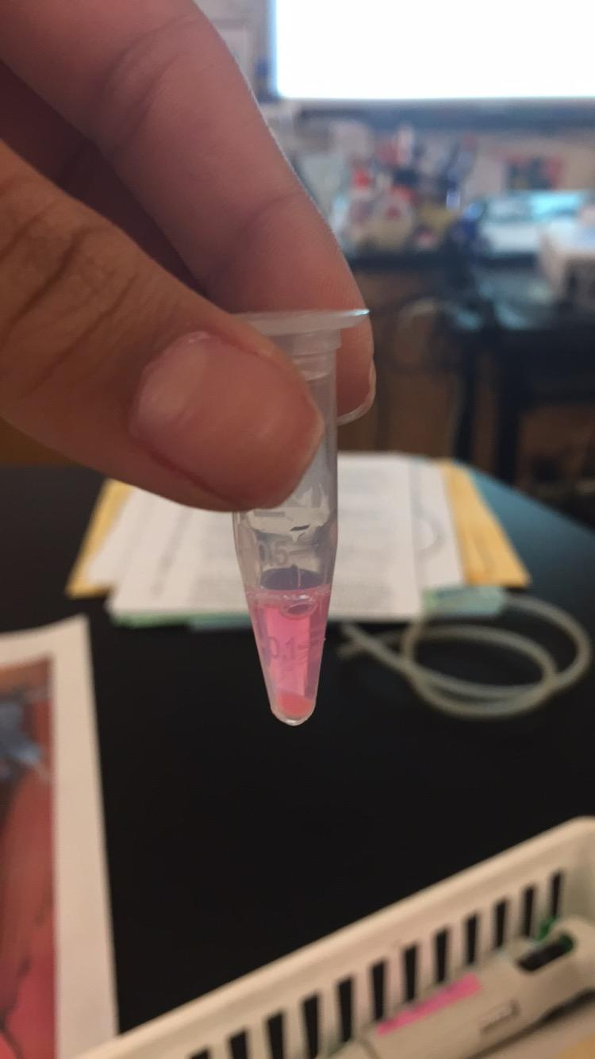
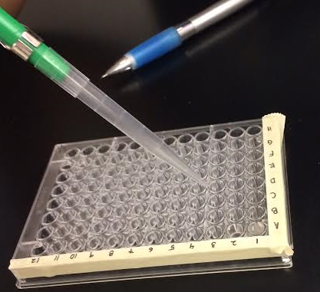
Things we’ve learned…
During the school year long program, biotech students:
Learn soft skills and general lab skills
Work with DNA – using the Amgen equipment, reagents, materials (extraction, separation by gel electrophoresis)
Analyze/Quantify DNA (Restriction digest – DNA and enzymes)
Amplify/Clone by PCR
Work with proteins
  Bacterial Transformation
  Growing Bacteria
  Isolation by Column Chromatography
  Analysis by PAGE

Slide 6
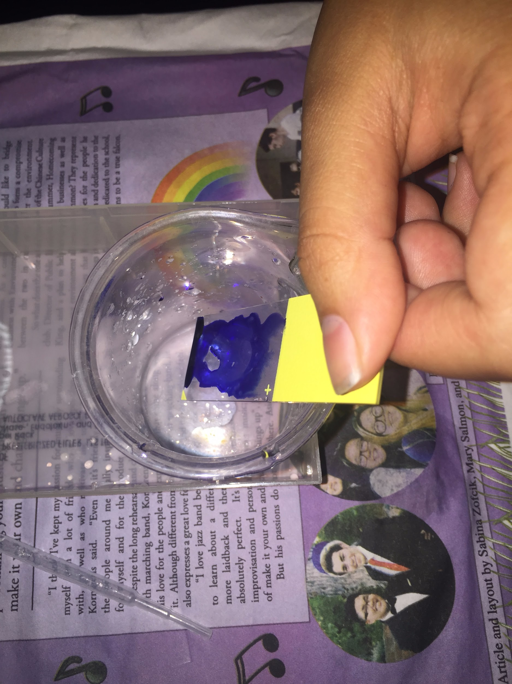
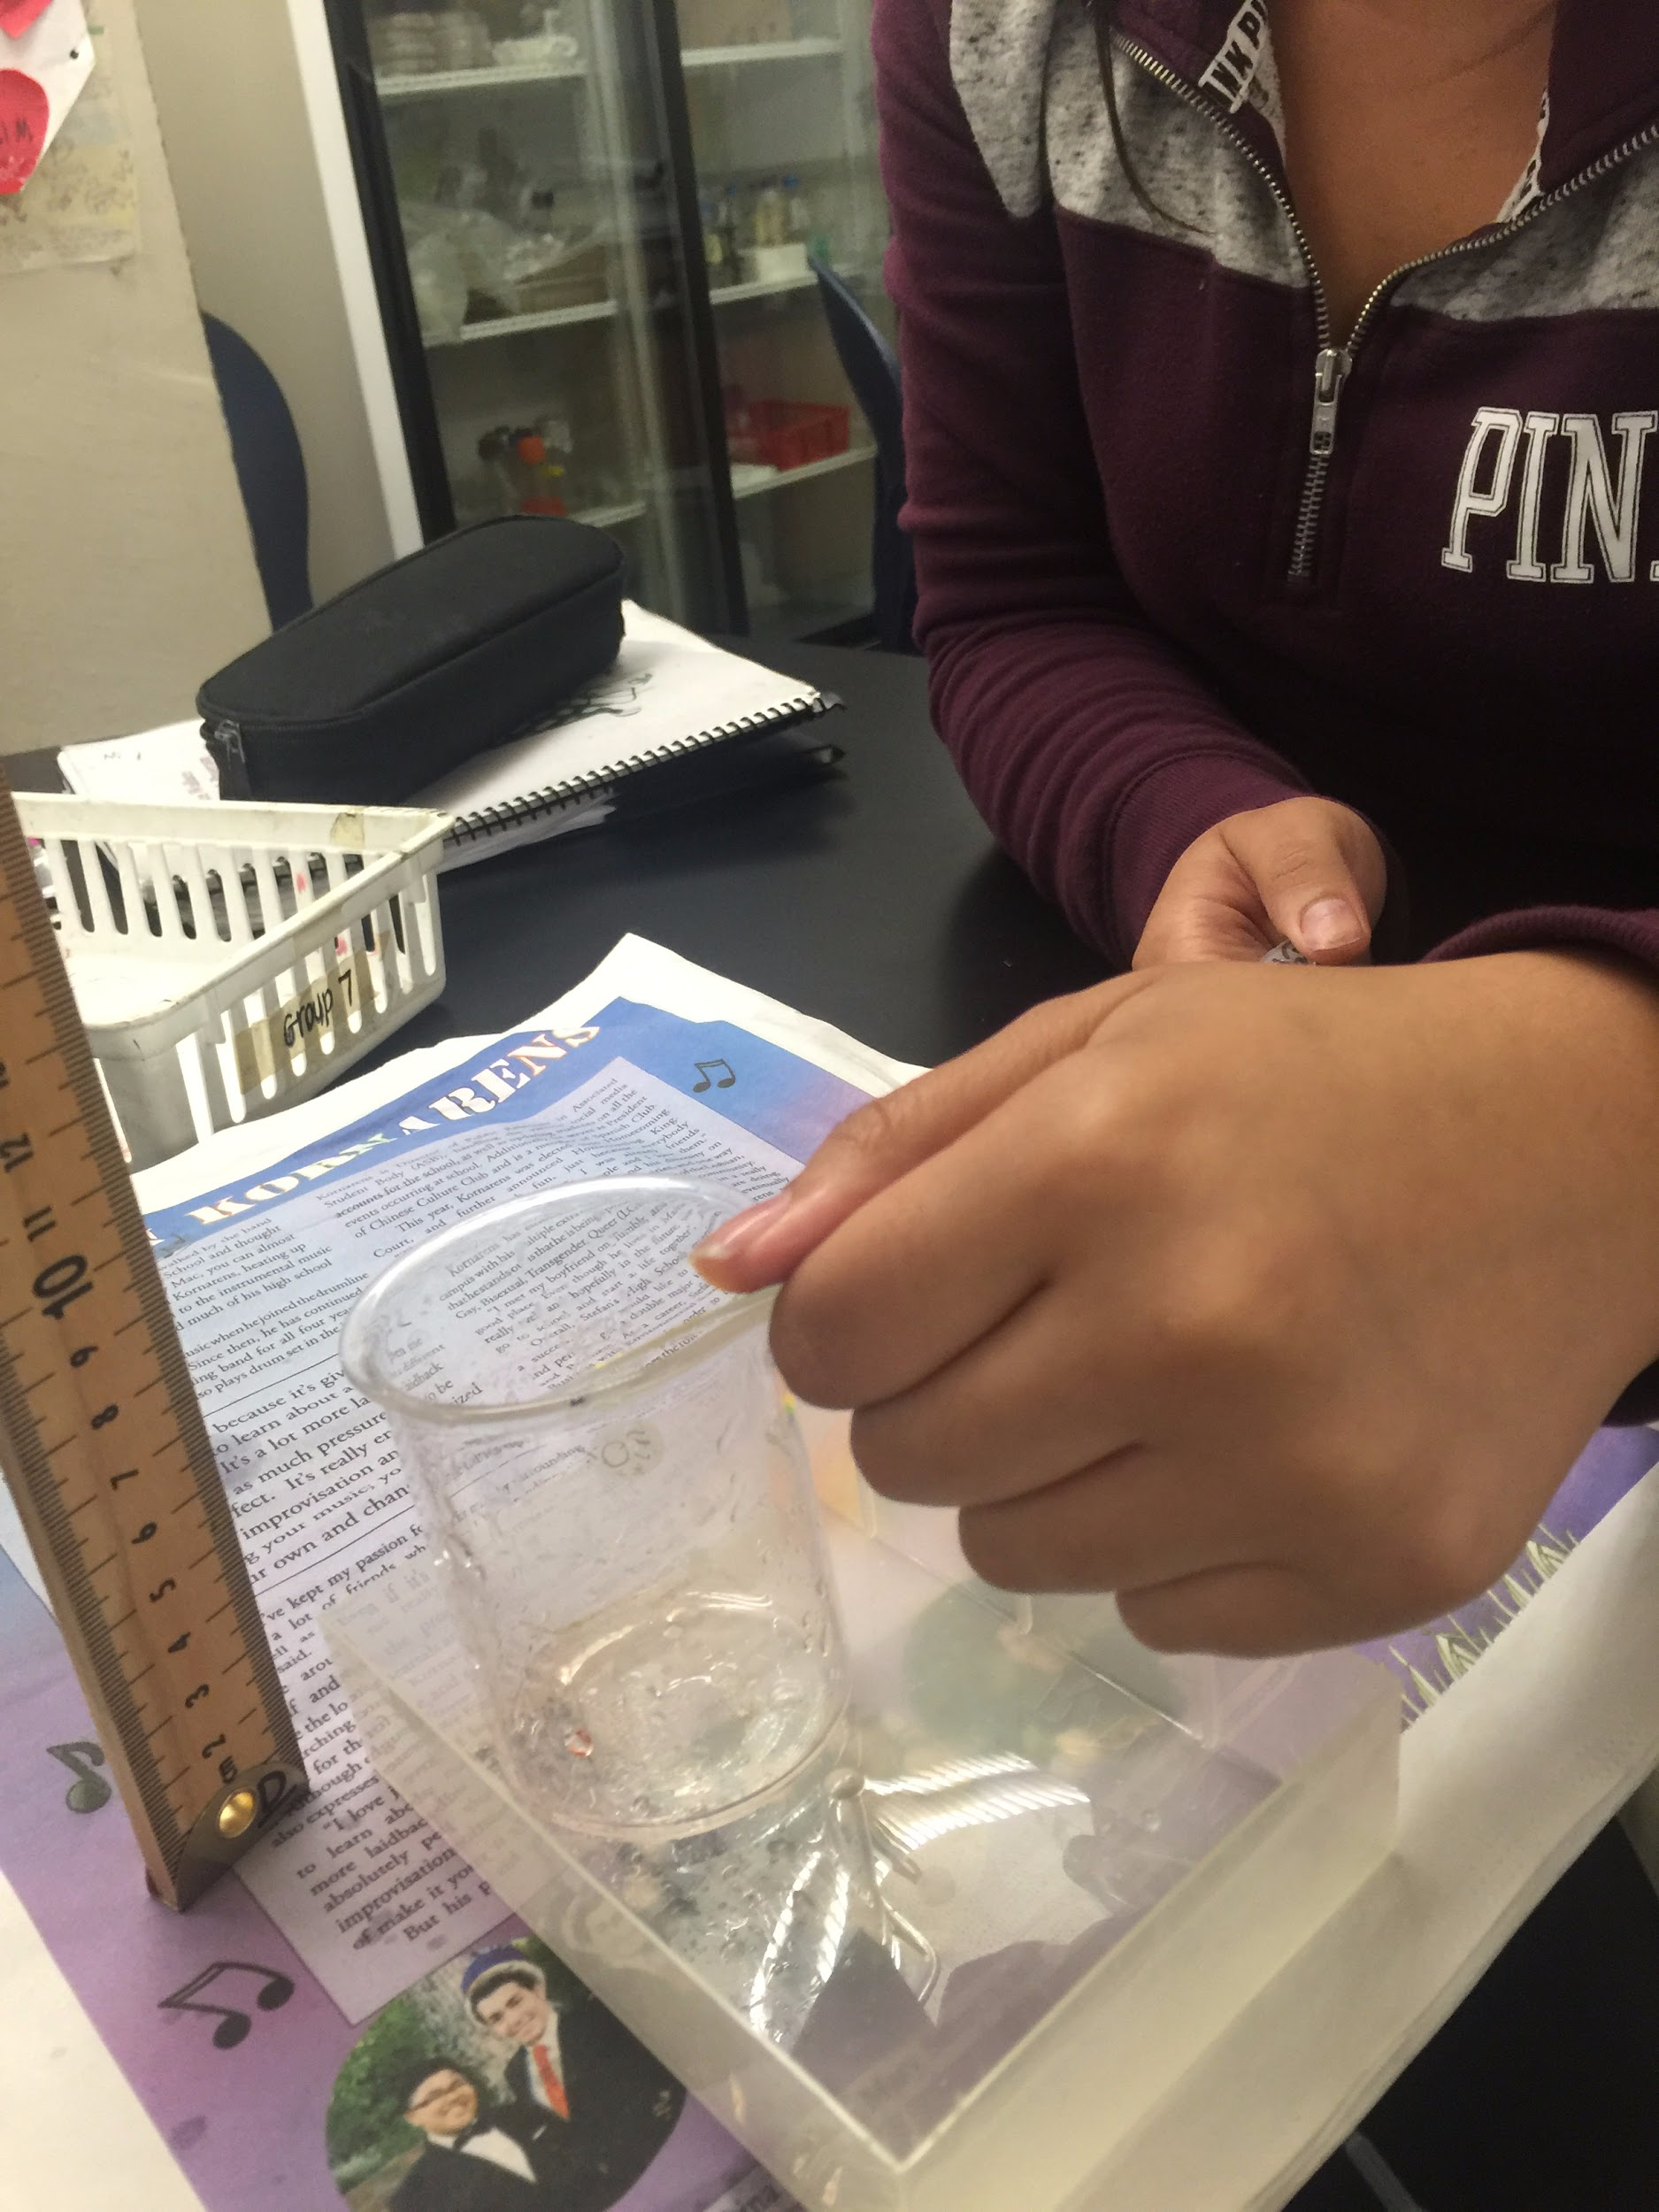
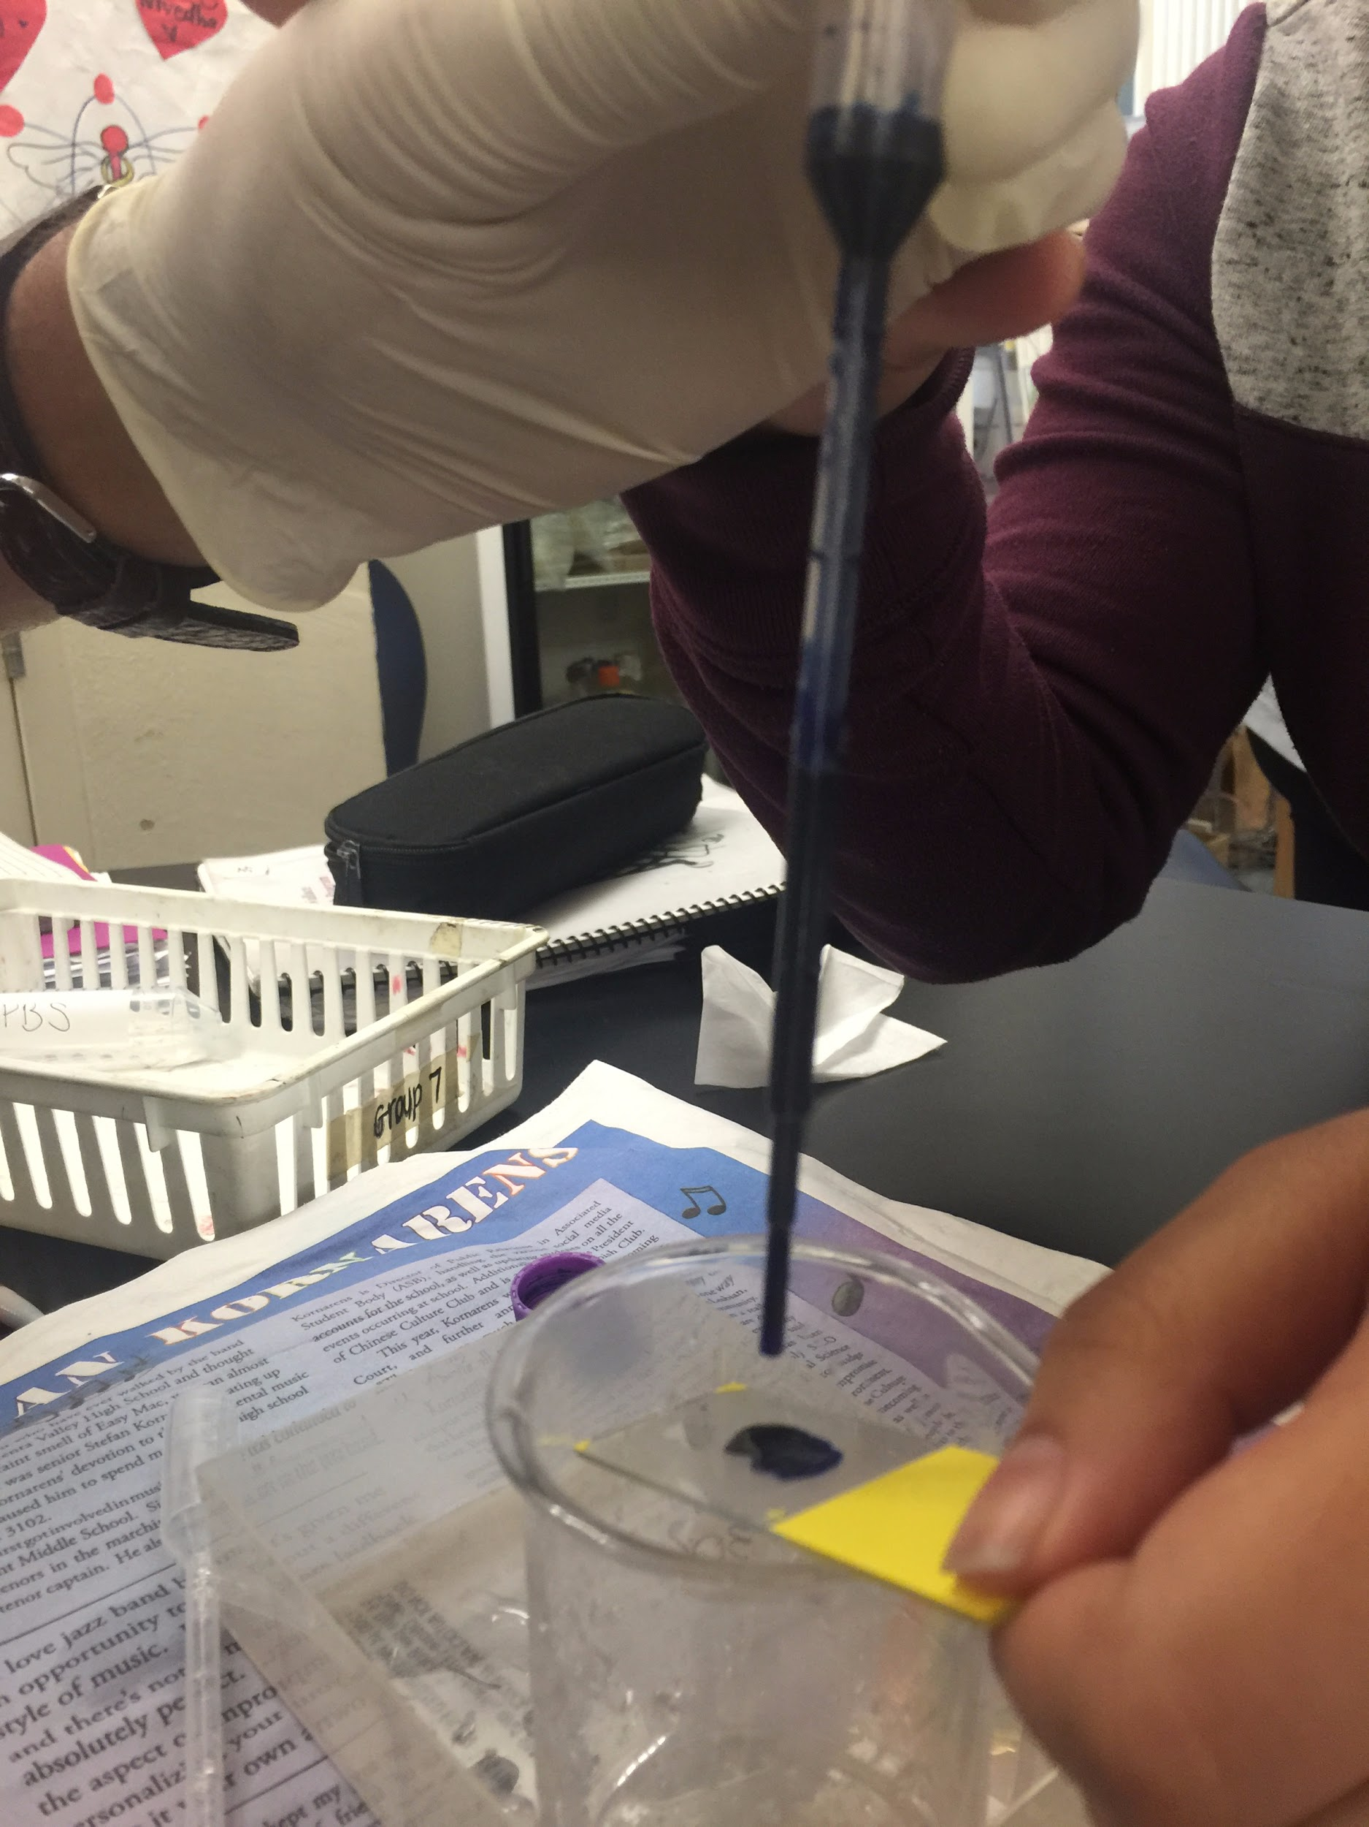
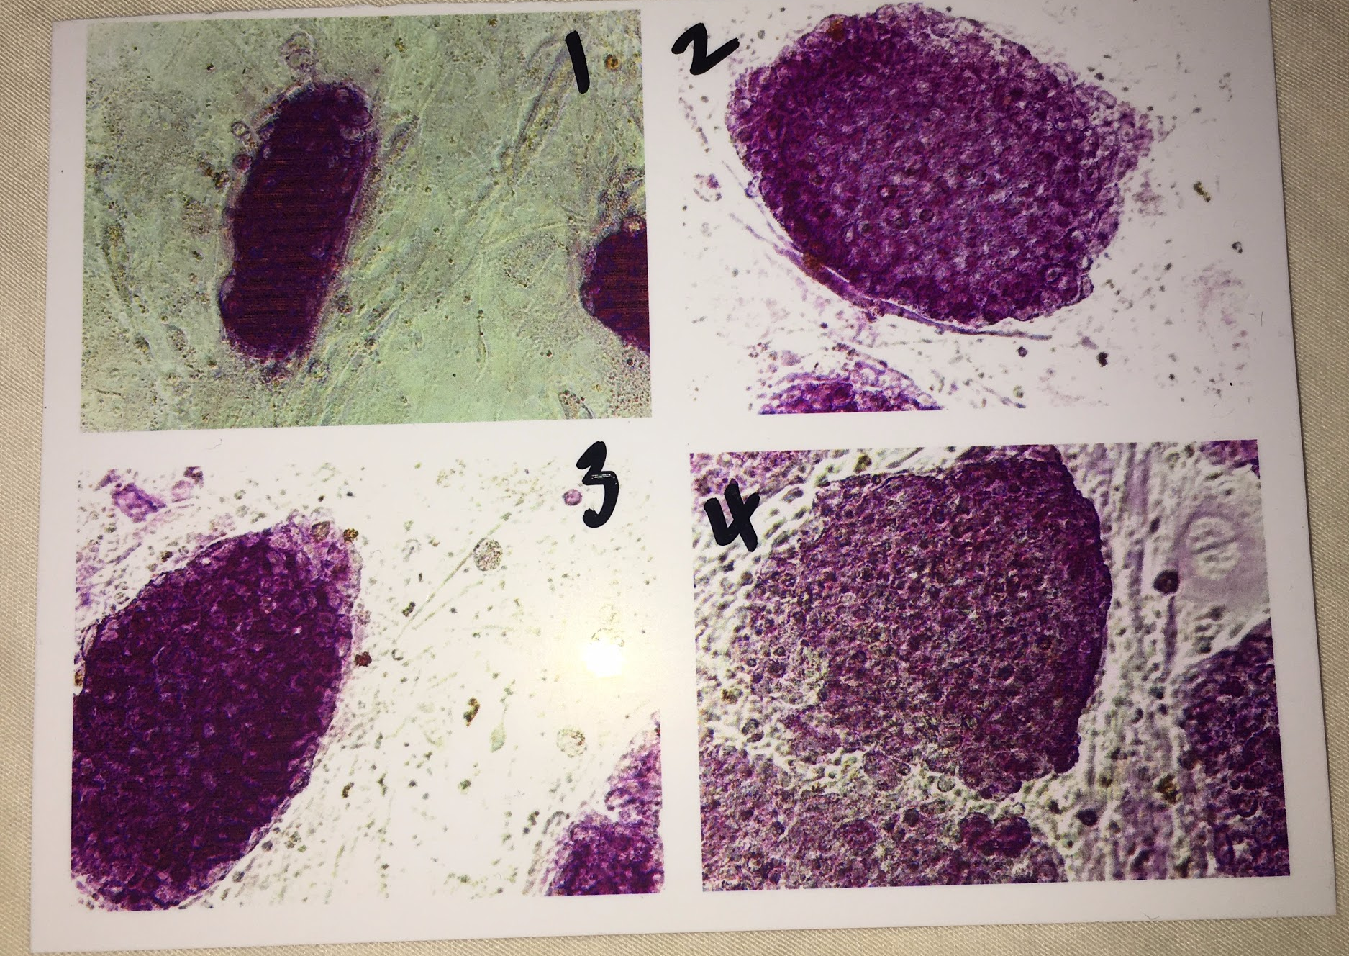
Stem Cell Module
Ms. Karol Lu from PCC taught us about stem cells for 2 weeks in our classroom.
We learned how to stain stem cells, how to karyotype, and how to tell if a cell was differentiated or not

Slide 7
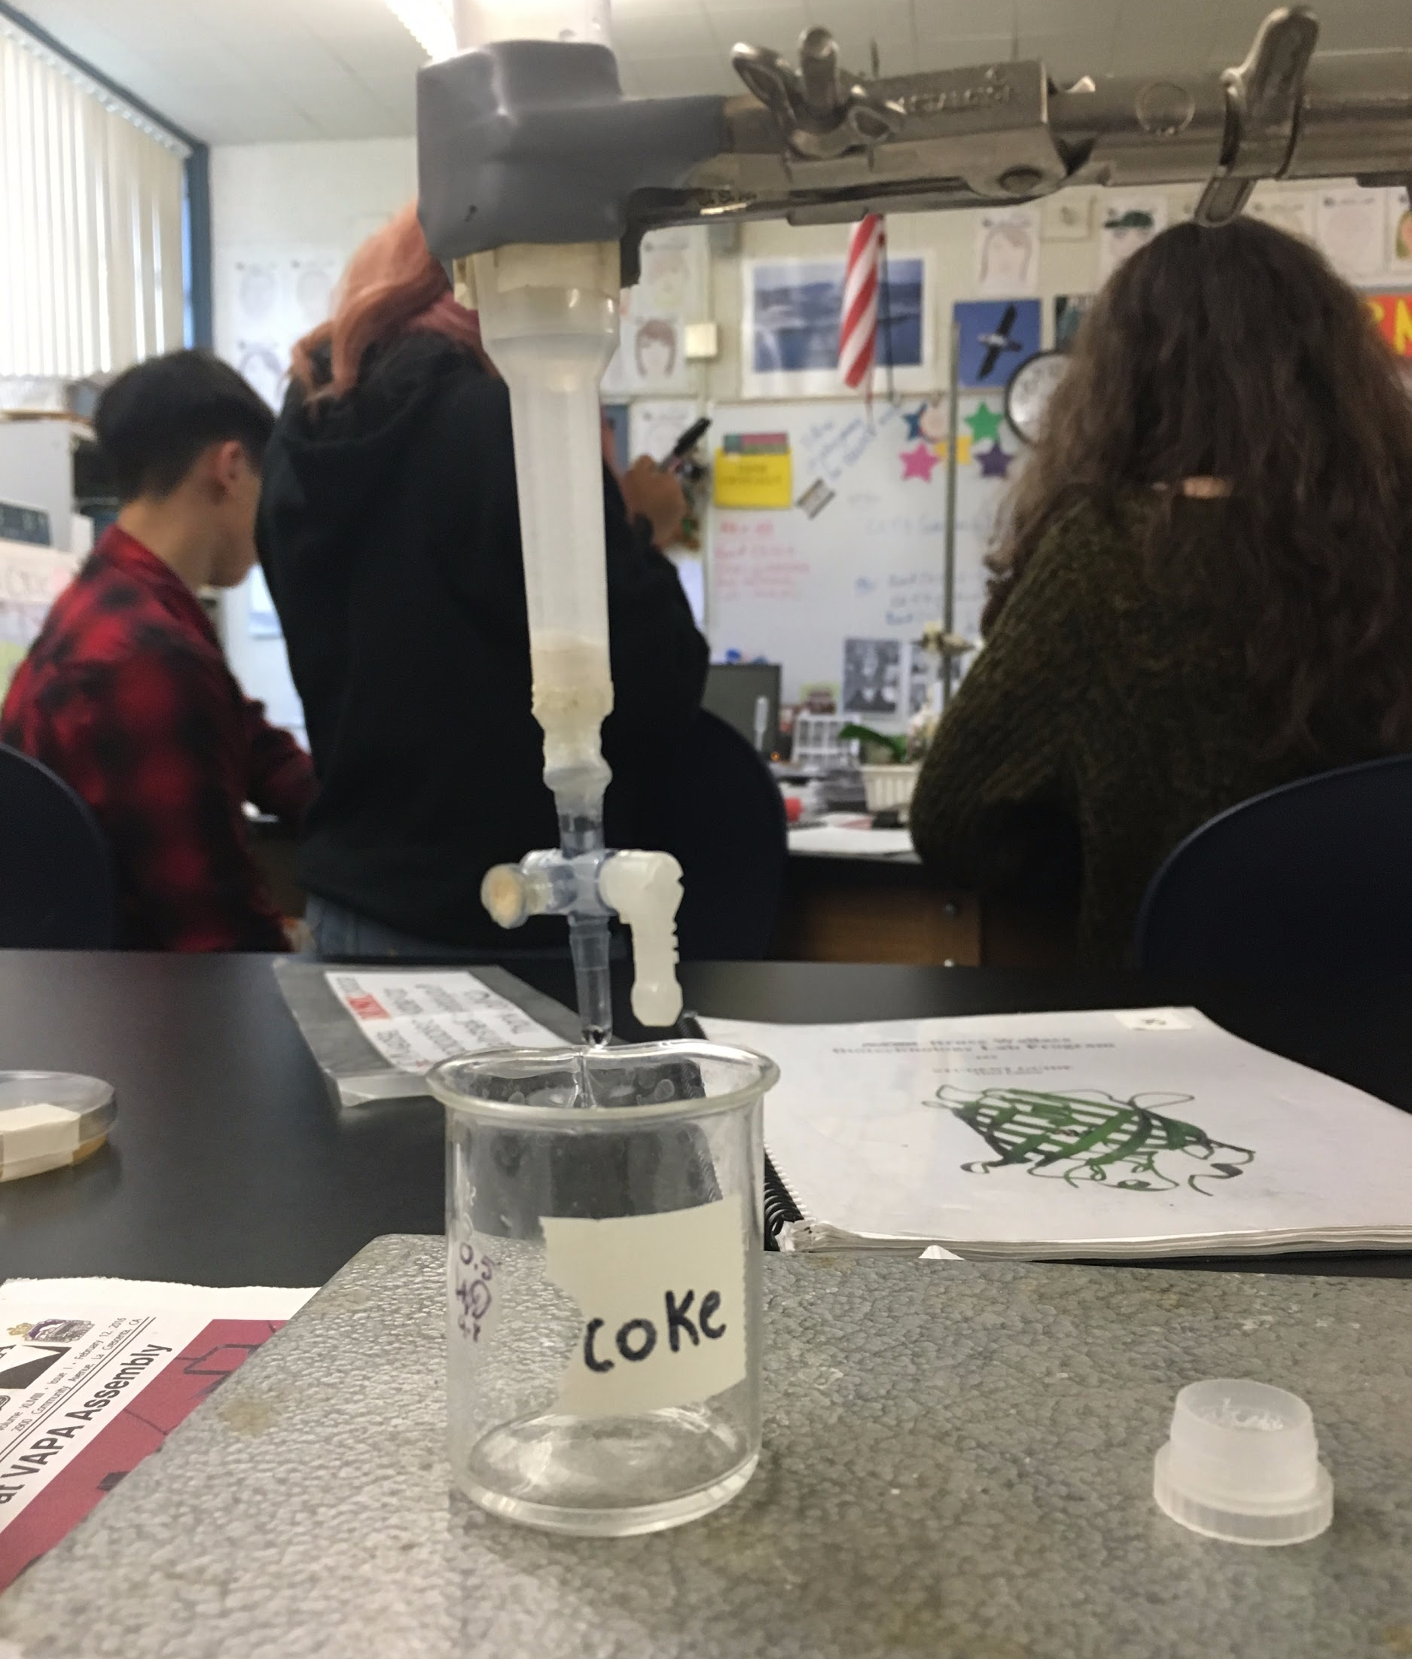
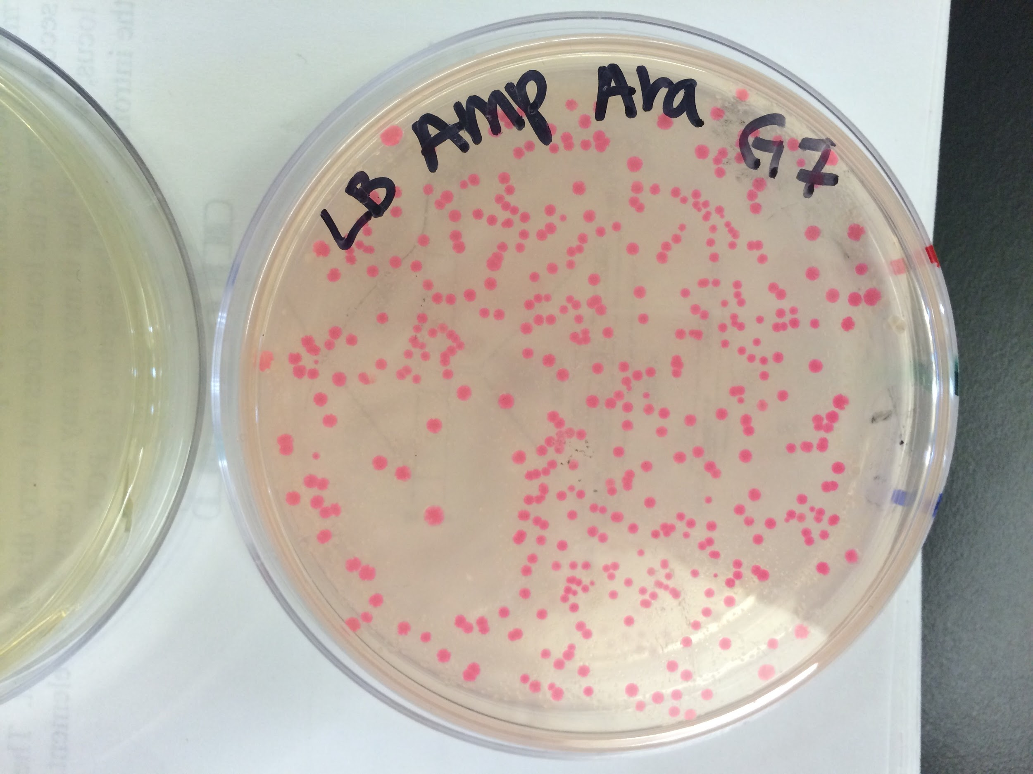
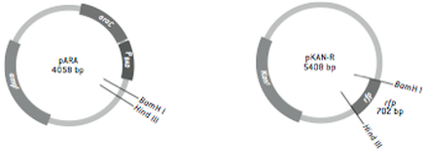
Amgen Labs: Green and Red
TRANSFORMATION OF CELLS TO GLOW GREEN/RED
Use restriction enzymes to cut the bacterial cell
Use ligase to “glue” the RFP/GFP gene into the cell
Confirm the recombinant plasmid
Spread the sample onto 3 different plates to confirm presence of transformed bacteria

Slide 8
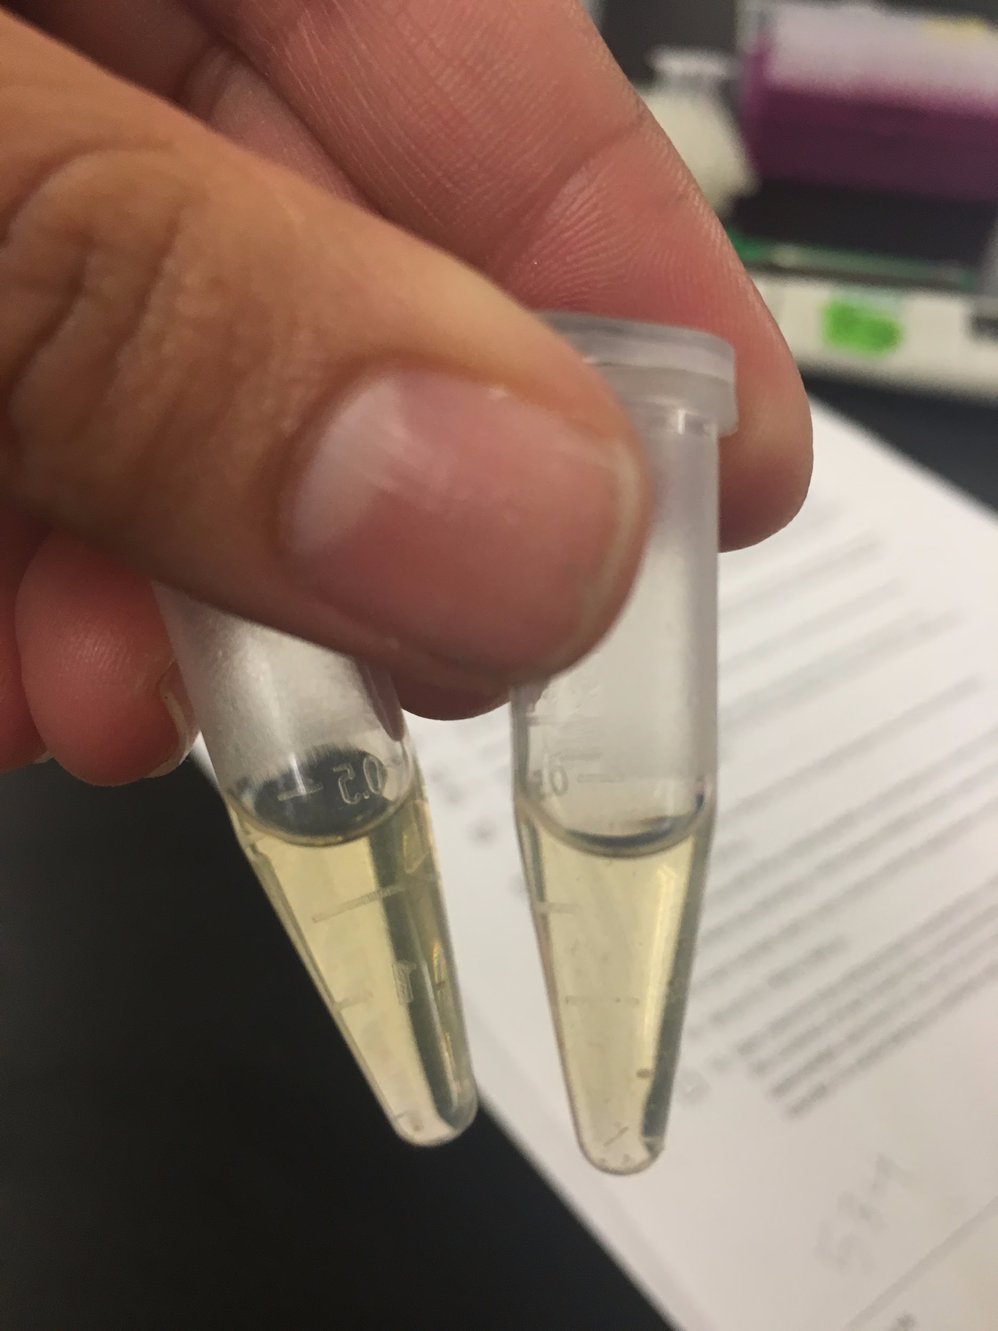
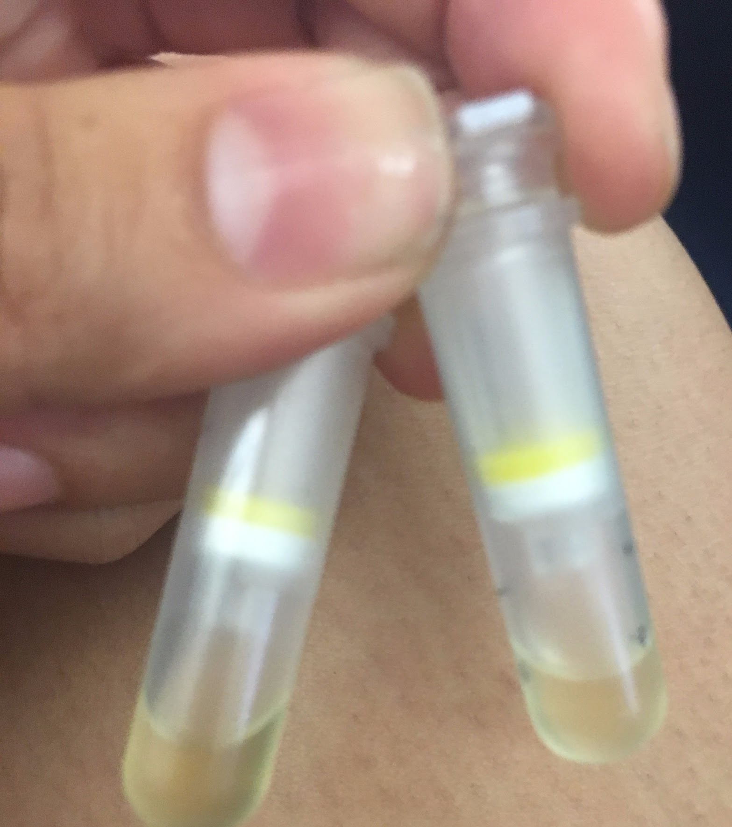
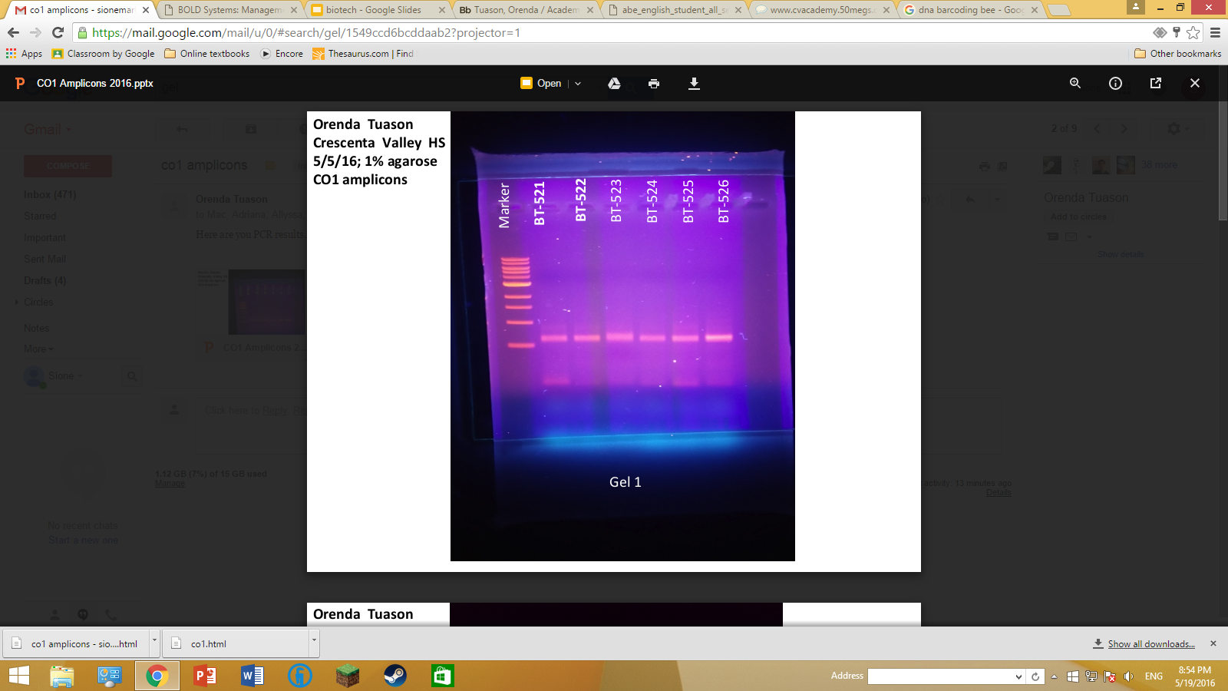
DNA Barcoding
Extract DNA from a bee abdomen
Separate gDNA using column chromatography
Amplify the DNA using PCR
Isolate the CO1 amplicon from the DNA
Confirm results using gel electrophoresis

Slide 9
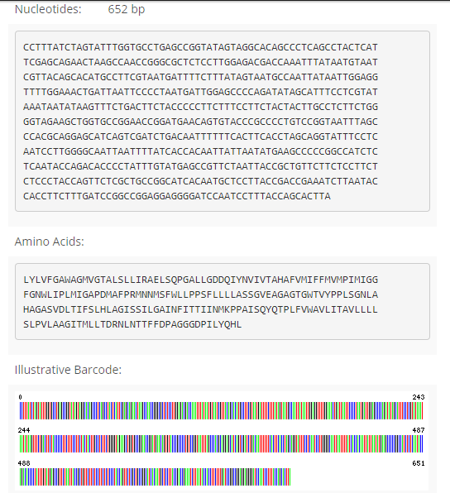
Authorship:
Xizhon’s DNA barcode: http://www.boldsystems.org/index.php/Public_RecordView?processid=SDP380014-15
Students are able to become published authors following the completion of the EBOL DNA Barcoding Labs
The results can be seen globally via the BOLD systems website
Publications are a scientist’s best mode of communication
Authorship serves a means for scientist to share discoveries, big or small
Majority of your fellow peers have not had the opportunity to conwillduct research of this kind, let alone become a published author
Your publication will help contribute to a vast, interconnected community of scientists that could incorporate your discoveries in their own findings

Slide 10
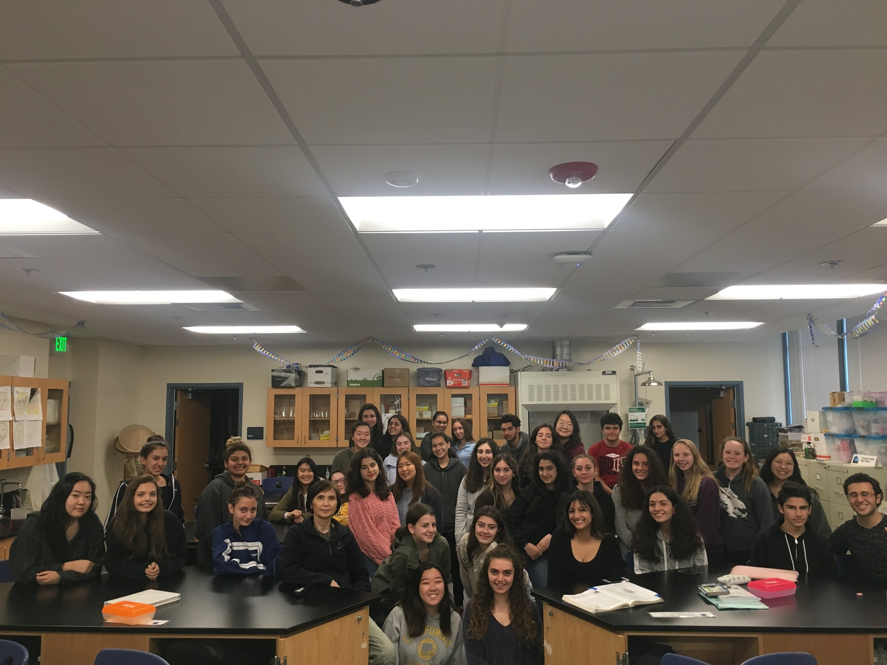
Biotech Class of 2017-2018

Slide 11

Thank you
for listening!

