Slide 1
Lifeguarding
By: Roz Kohan

Slide 2
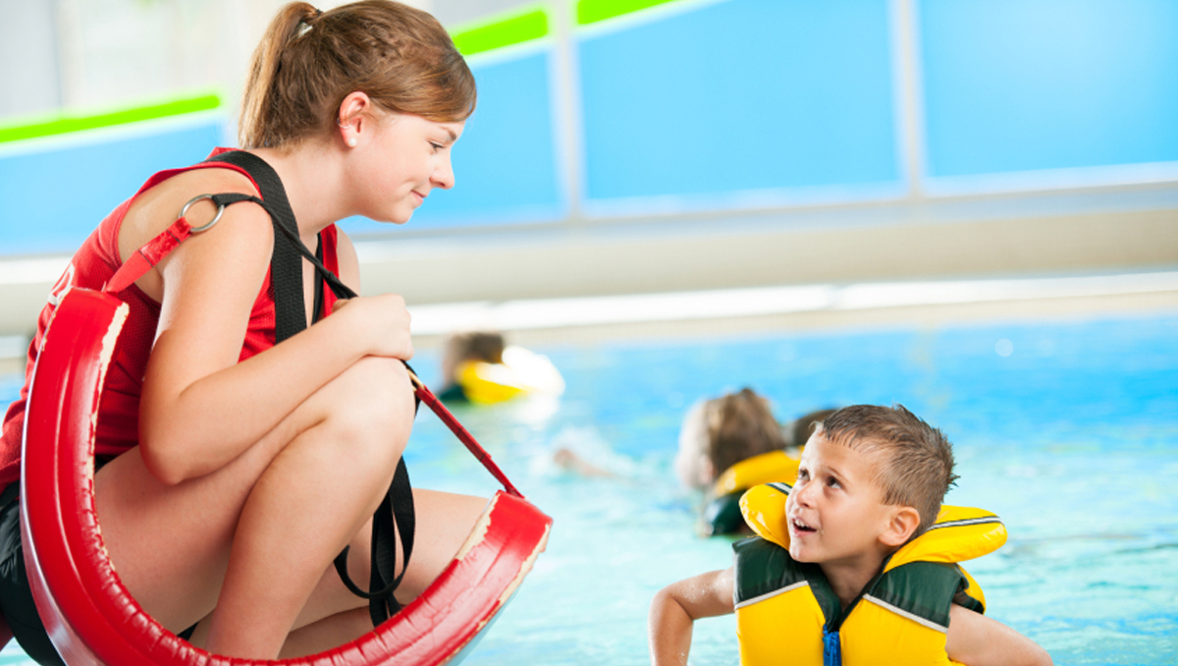
Responsibilities of a Lifeguard
Ensure that everyone is being safe and following all rules
Preventative lifeguarding
Providing emergency care and treatment until arrival of EMS
Ensuring that the facility is kept clean and organized

Slide 3
Why is lifeguarding so important?
Drowning is the leading cause of accidental death in children 5/u
  Lifeguards are an important part to help prevent drownings
Deaths most common in shallow waters and with adult “supervision”
  Drownings occur in unexpected circumstances

Slide 4

How It Started and Evolved
Joined the Academy
Took Lifeguarding class
Started lifeguarding private parties
Got a job at the YMCA of the Foothills
Expand lifeguarding profile with hours of experience and saving lives

Slide 5
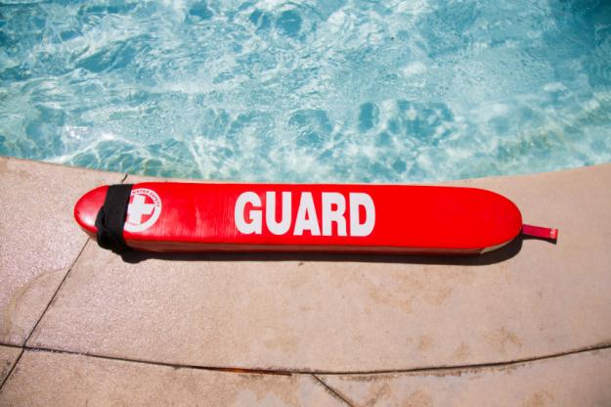
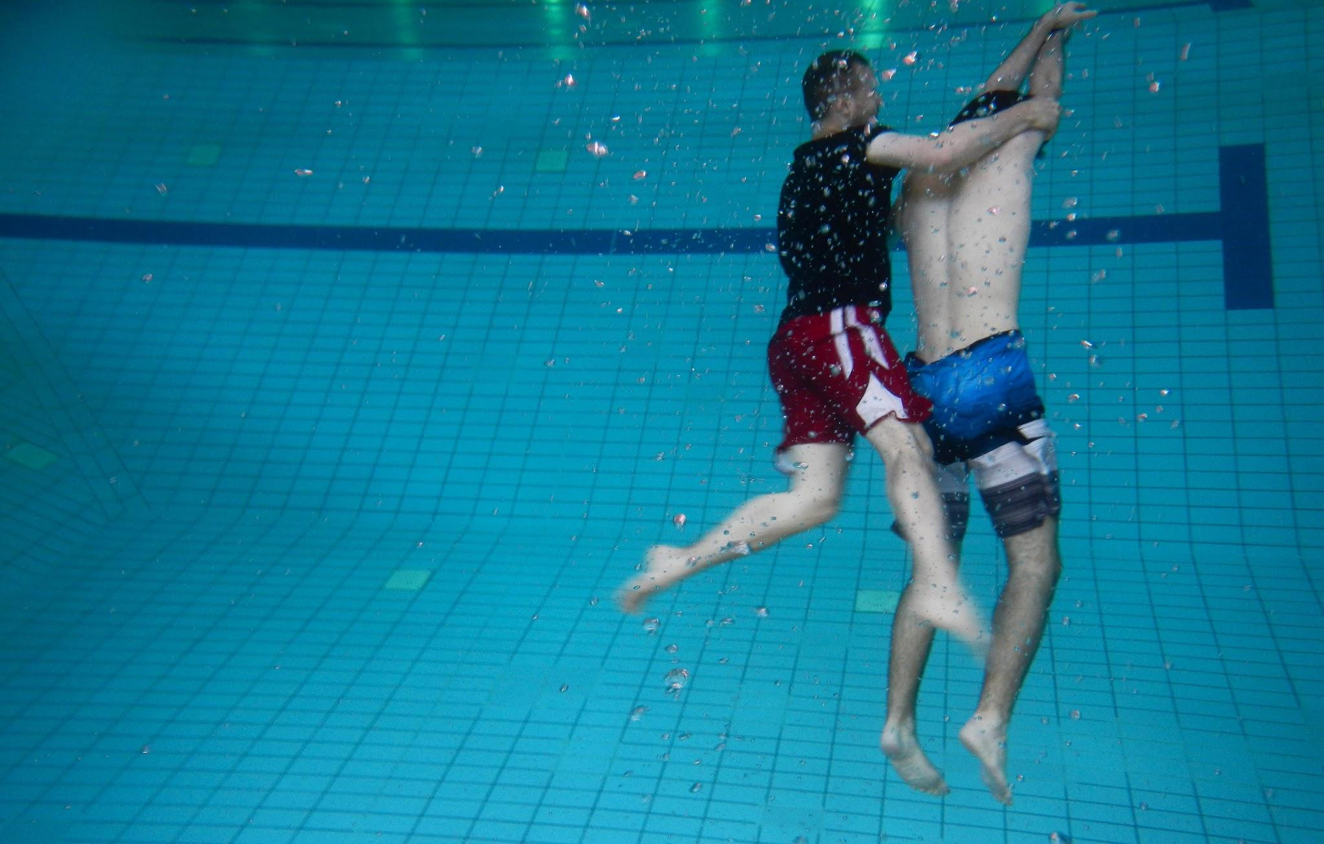
Purpose of Academy Course
Teach students how to prevent, recognize and respond to aquatic emergencies
Provide care for breathing and cardiac emergencies, injuries and sudden illnesses

Slide 6
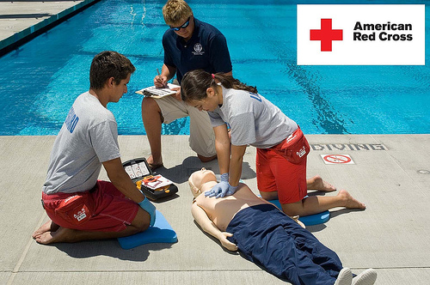
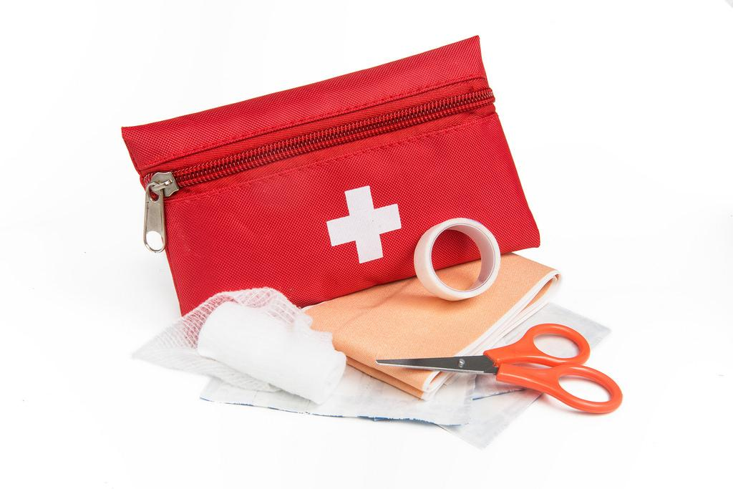
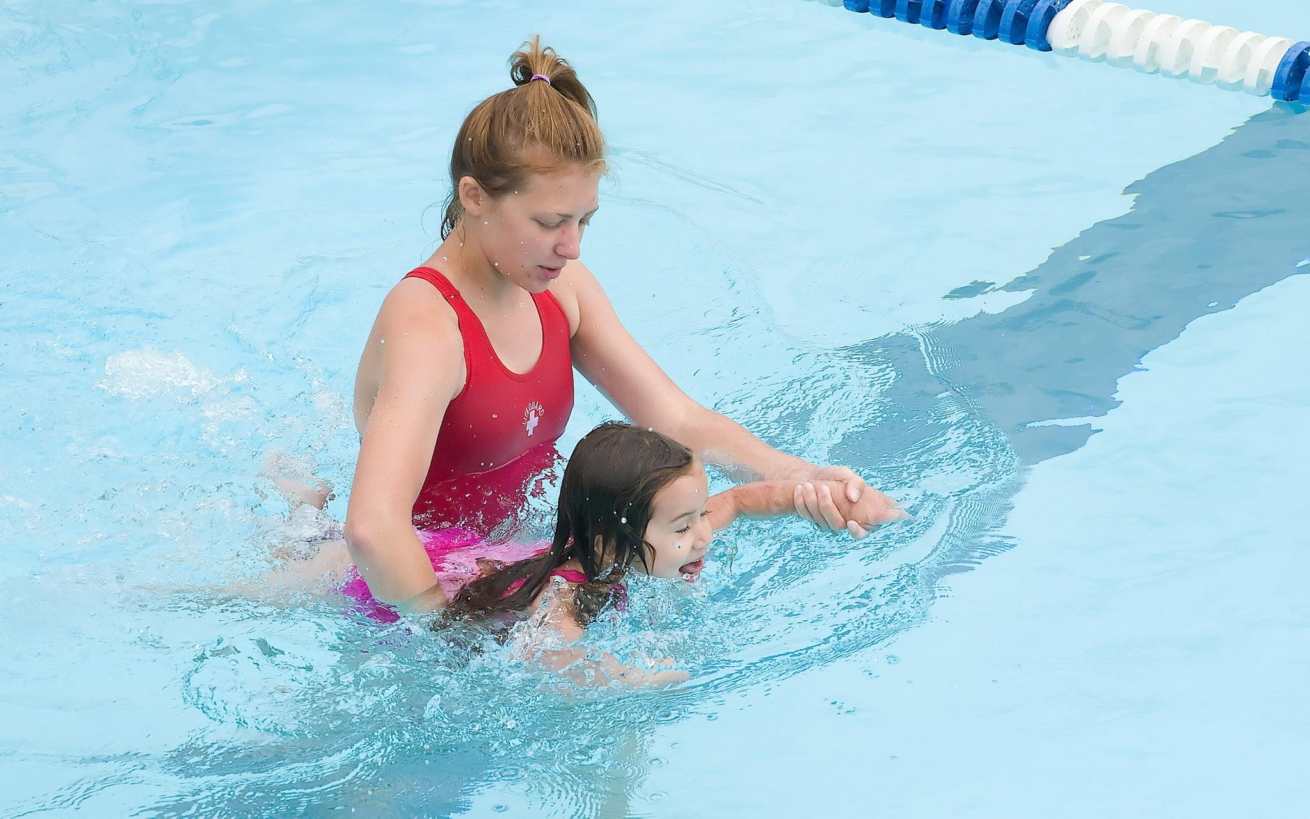
Certifications
Lifeguarding
CPR/AED
First Aid
Title 22
Water Safety Instruction
Notes:
Talk about expiration dates

Slide 7
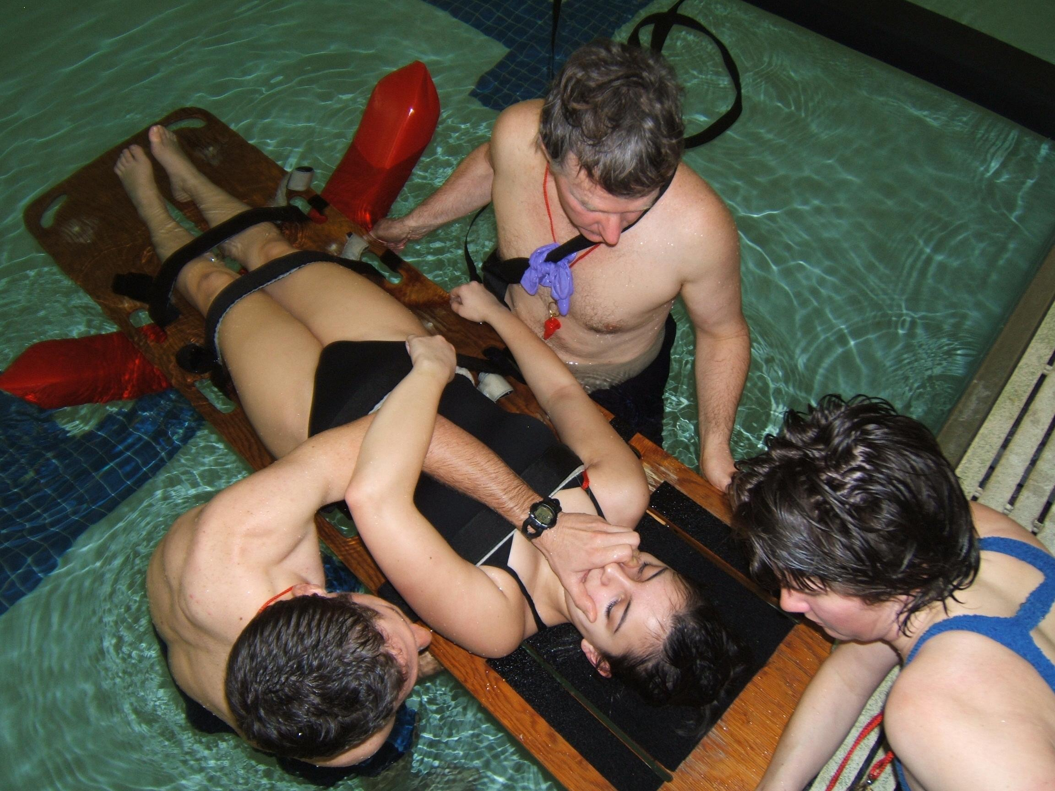
Other skills that you will learn
All methods of injury prevention by the water
How to deal with people
How to deliver a baby
Tips on getting a job and what to do on your job
Public speaking
Teaching how to swim
Dealing with spinal injuries
The Heimlich maneuver
Notes:
Treading water

Slide 8

Benefits
You get a paid job
It counts as an internship for the Academy
You learn how to save people! (the best part)

Slide 9
Personal Experience
Notes:
A little girl in swim lessons was sitting on the steps right in front of me.

Slide 10
Questions?

